Slide 1
Python

Slide 2
INTRODUCTION TO FUNCTION
MODULES AND PACKAGES
FILE OPERATIONS
CLASSES AND OBJECTS
EXCEPTION HANDLING
INTRODUCTION TO OOPS
DATABASE
GUI PROGRAMMING
MULTITHREADING
REGULAR EXPRESSIONS
PYTHON MODULES
PYTHON MATPLOTLIB

Slide 3
contents
GETTING STARTED
PYTHON FUNDAMENTALS
DATA HANDLING
STRING MANIPULATION
LIST MANIPULATION
TUPLES
DICTIONARIES
SET AND FROZENSET
OPERATORS
PROGRAM CONTROL FLOW

Slide 4
1. GETTING STARTED
1.1 History and need of python
1.2 Applications of python
1.3 Advantages of python
1.4 Disvantages of python
1.5 Installing python
1.6 program structure
1.7 Interactive Shell
1.8 Executable or script files
1.9 Userinterface or IDE

Slide 5
History of python
Python is an programming language,It was created by Guido van Rossum, and released in 1991.
Python is an interpreted high-level general-purpose programming language. Its design philosophy emphasizes code readability with its use of significant indentation. Its language constructs as well as its object-oriented approach aim to help programmers write clear, logical code for small and large-scale projects.
Guido van Rossum began working on Python in the late 1980s, as a successor to the ABC programming language, and first released it in 1991 as Python 0.9.0. Python 2.0 was released in 2000 and introduced new features, such as list comprehensions and a garbage collection system using reference counting. Python 3.0 was released in 2008 and was a major revision of the language that is not completely backward-compatible. Python 2 was discontinued with version 2.7.18 in 2020.
Python consistently ranks as one of the most popular programming languages.

Slide 6
fun fact: The Name python is inspired from an BBC comedy series “monty python’s flying car”. Van Rossum thought he needed a name that was short, unique, and slightly mysterious, so he decided to call the language Python.
Python is dynamically-typed and garbage-collected. It supports multiple programming paradigms, including structured (particularly, procedural), object-oriented and functional programming. It is often described as a "batteries included" language due to its comprehensive standard library.
Since 2003, Python has consistently ranked in the top ten most popular programming languages in the TIOBE Programming Community Index where, as of February 2021, it is the third most popular language (behind Java, and C). It was selected Programming Language of the Year (for "the highest rise in ratings in a year") in 2007, 2010, 2018, and 2020 (the only language to do so four times).

Slide 7
An empirical study found that scripting languages, such as Python, are more productive than conventional languages, such as C and Java, for programming problems involving string manipulation and search in a dictionary, and determined that memory consumption was often "better than Java and not much worse than C or C++".
Large organizations that use Python include Wikipedia, Google, Yahoo!, CERN, NASA, Facebook, Amazon, Instagram, Spotify and some smaller entities like ILM and ITA. The social news networking site Reddit was written mostly in Python.

Slide 8
1.2 Application of python
The applications are:
i. Web and internet development
ii. Games
iii Language development
iv. Operating system
v. Image processing and graphic design application
vi. Scientific and computational applications
vii. Business application development

Slide 9
1.3 Advantages of python
The advantages are:
a)Interpreted
b)Free and open source
c)Extensible
d)Object oriented
e)Built-in data structure
f)Readability
g)High-level language
h)Cross platform

Slide 10
1.4 Disadvantages of python
Disadvantages of Python are:
Speed
Python is slower than C or C++. But of course, Python is a high-level language, unlike C or C++
it's not closer to hardware.
Mobile Development
Python is not a very good language for mobile development . It is seen as a weak language
for mobile computing. This is the reason very few mobile applications are built in it like
Carbonnelle.
Memory Consumption
Python is not a good choice for memory intensive tasks. Due to the flexibility of the data-types, Python's memory consumption is also high.

Slide 11
Database Access
Python has limitations with database access . As compared to the popular technologies like JDBC and ODBC, the Python's database access layer is found to be bit underdeveloped and primitive . However, it cannot be applied in the enterprises that need smooth interaction of complex legacy data .
Runtime Errors
Python programmers cited several issues with the design of the language. Because the language is dynamically typed , it requires more testing and has errors that only show up at runtime .

Slide 12
1.5 Installing python
To install python ,we need to go to python’s official site.
step1 :visit https://www.python.org/ , In their we can see an option download from there we can get the latest version of python.
step 2: after download Install that pacakage and make it run.
step3 : To check if all are done correctly, go to commad prompt in your pc.
step4: type python --version , we will get version of the python if it is installed.
And if we type python , we can run python command their too, for checking purpose.

Slide 13
1.6 program structure
Attributes and Imports:
The structure Python Program consists of three files such as : aa.py,bb.py and cc.py. The file model aa.py is chosen for high level file . it is known as a simple text file of statements. And it can be executed from bottom to top when it is launched. Files bb.py and c.py are modules. They are calculated as better text files of statements as well. But they are generally not started Directly. Identically this attributes define Programming structure of Python.
Functions:
For example bb.py defines a function called spam. For external use. bb.py has python def statement to start the function.later operated by passing one or more values like the below.
Def spam(text): print text, ‘spam’
If aa.py wants to use spam, it has python statements like below
Import bb bb.spam (‘gumby’)

Slide 14
Statements:
Python import statement gives file aa.py access to file bb.py. it shows that “load filebb.py” and gives access to all its attributes by name bb” import statements will execute and implement other file for at run-time. In python cross file module is not updated until import statements are executed .
The next part is statements will call the function spam. module b used by object attribute notation. bb.spam means get value of name spam within object bb. And we can implement a string in parenthesis if these files run by aa.py.
In regular if we see object. Attribute in total python scripts. Many objects have attributes traced by “python operators".
The process of Importing considered as general in total python. Any sort of file can get tools from any file. Getting of chains can be go as deep as you can . By this Instance you will get it notified module aa can import bb and bb can Import cc, and cc again Imports bb. correspondingly this statements include Programming structure of Python.

Slide 15
Modules :
If we take this as a part , python serves as biggest company structure. Modules are having top end of code. By coding components in module files.used in any program files.If we take an example function bb.spam is regular purpose tool. We can again implement that in a different program. This is simply known as bb.py from any other program files.
Standard library files:
Python has large collection of modules known as standard library.it contains 200 modules at last count. It is platform independent common programming works. Such as GUI Design, Internet and network scripting. Text design matching, Operating system Interfaces. So, Comparatively all the Above will explain Programming structure of Python.

Slide 16
1.7 Interactive Shell
The Python interpreter can be used from an interactive shell.
The interactive shell is also interactive in the way that it stands between the commands or actions and their execution. In other words, the shell waits for commands from the user, which it executes and returns the result of the execution. Afterwards, the shell waits for the next input.
open cmd then type “python”.
Python 3.9.2 (tags/v3.9.2:1a79785, Feb 19 2021, 13:44:55) [MSC v.1928 64 bit (AMD64)] on win32
Type "help", "copyright", "credits" or "license" for more information.
>>>
after that this command will be appearing , and your shell is started.
we can write python commands and to exit that we can type exit()

Slide 17
1.8 Executable or Script files
The file with extension .py are python files, which has python scripits or program to execute some problem or anything as an output.
The most basic and the easy way to run Python scripts is by using the python command. You need to open a command-line and type the word python followed by the path to your script file, like this: python first_script.py Hello World! Then you hit the ENTER button from the keyboard and that's it.

Slide 18
1.9 UserInterface or IDE
IDE stands for Integrated Development Environment. It’s a coding tool which allows you to write, test, and debug your code in an easier way, as they typically offer code completion or code insight by highlighting, resource management, debugging tools,… And even though the IDE is a strictly defined concept, it’s starting to be redefined as other tools such as notebooks start gaining more and more features that traditionally belong to IDEs.
popular IDE
Visual studio code
pycharm
Jupiter etc...

Slide 19
2. PYTHON FUNDAMENTALS
2.1 Working with Interactive Mode.
2.2 Working with script mode.
2.3 Python character set.
2.4 Python Token, keywords, Identifiers,Literals,Operators variables,Assignments
2.5 Input and output in python

Slide 20
2.1 Working with Interactive Mode
The interactive mode involves running your codes directly on the Python shell which can be accessed from the terminal of the operating system.
The code executes via the Python shell, which comes with Python installation. Interactive mode is handy when you just want to execute basic Python commands or you are new to Python programming and just want to get your hands dirty with this beautiful language.
To access the Python shell, open the terminal of your operating system and then type "python". Press the enter key and the Python shell will appear. This is the same Python executable you use to execute scripts, which comes installed by default on Mac and Unix-based operating systems.

Slide 21
The >>> indicates that the Python shell is ready to execute and send your commands to the Python interpreter. The result is immediately displayed on the Python shell as soon as the Python interpreter interprets the command.
eg1:
>>> print("Hello World")
Hello World
>>>
eg2:
>>> 122
122
>>> print(4 * 20)
80
>>> "py" * 5
'pypypypypy'
>>>

Slide 22
The following are the advantages of running your code in interactive mode:
Helpful when your script is extremely short and you want immediate results.
Faster as you only have to type a command and then press the enter key to get the results.
Good for beginners who need to understand Python basics.
The following are the disadvantages of running your code in the interactive mode:
Editing the code in interactive mode is hard as you have to move back to the previous commands or else you have to rewrite the whole command again.
It's very tedious to run long pieces of code.

Slide 23
2.2 working with Script mode
In script mode, You write your code in a text file then save it with a .py extension which stands for "Python". Note that you can use any text editor for this, including Sublime, Atom, notepad++, etc.
If you are in the standard Python shell, you can click "File" then choose "New" or simply hit "Ctrl + N" on your keyboard to open a blank script in which you can write your code. You can then press "Ctrl + S" to save it.
After writing your code, you can run it by clicking "Run" then "Run Module" or simply press F5.

Slide 24
Let us create a new file from the Python shell and give it the name "hello.py". We need to run the "Hello World" program. Add the following code to the file:
print("Hello World")
Click "Run" then choose "Run Module". This will run the program:
Hello World
Other than executing the program from the graphical user interface, we can do it from the terminal of the operating system. However, you must be aware of the path to the directory where you have saved the file.
Open the terminal of your operating system then navigate to the location of the file. Of course, you will use the "cd (change directory)" command for this.

Slide 25
Once you reach the directory with the file, you will need to invoke the Python interpreter on the file. This can be done using the following syntax:
> python <filename>
To run the Python file from the terminal, you just have to type the python keyword followed by the name of the file. In our case, we need to run a file named "hello.py". We need to type the following on the terminal of the operating system:
> python hello.py
Hello World

Slide 26
The following are the advantages of running your code in script mode:
It is easy to run large pieces of code.
Editing your script is easier in script mode.
Good for both beginners and experts.
The following are the disadvantages of using the script mode:
Can be tedious when you need to run only a single or a few lines of code.
You must create and save a file before executing your code.

Slide 27
Difference between script mode and Interactive mode.
The interactive mode involves running your codes directly on the Python shell which can be accessed from the terminal of the operating system.
In the script mode, you have to create a file, give it a name with a .py the extension then runs your code.
The interactive mode is suitable when running a few lines of code.
The script mode is recommended when you need to create large applications.

Slide 28
2.3 Python character set
Character set is the set of valid characters that a language can recognize. A character represents any letter, digit or any other symbol.
Python has the following character sets:
· Letters – A to Z, a to z
· Digits – 0 to 9
· Special Symbols - + - * / etc.
· Whitespaces – Blank Space, tab, carriage return, newline, form feed
· Other characters – Python can process all ASCII and Unicode characters as part of data or literals.

Slide 29
Tokens
In a passage of text, individual words and punctuation marks are called tokens lexicalunite or lexical elements.
The smallest individual unit in a program is called token.
Python has the following tokens:
(i) Keyword (ii) Identifiers
(iii) Literals (iv) Operators
(v) Punctuators

Slide 30
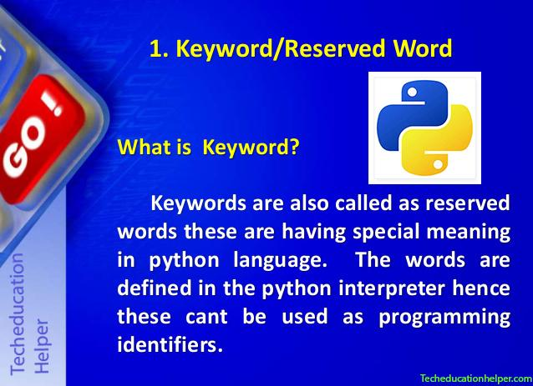
Reserved words
Reserved words also called keywords are defined with predefined meaning and syntax in python language. These keywords have to be used to develop programming instructions.
Reserved words can’t be used as identifiers for other programming elements like name of variable, function etc.

Slide 31
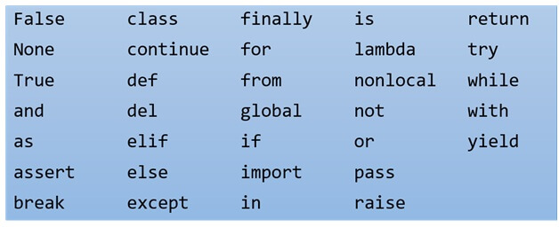
Reserved words in python

Slide 32
Variables or identifiers
A variable is created the moment we first assign a value to it. A variable is a name given to a memory location. It is the basic unit of storage in a program.
The value stored in a variable can be changed during program execution.
A variable is only a name given to a memory location, all the operations done on the variable effects that memory location.

Slide 33
  we can declare a variable by assigning a value to it.
  At the moment of assigning a value to that letter, that letter became a variable.
  assignment operator
  variable x = 6 value
  print(x)
  output :
  6
  choosing a name of an variable is very important in a python program or any program.

Slide 34
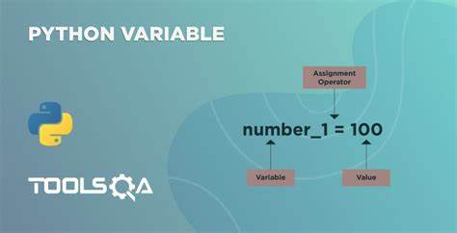
Rules for creating variables
A variable name must start with a letter or the underscore character.
A variable name cannot start with a number.
A variable name can only contain alpha-numeric characters and underscores (A-z, 0-9, and _ ).
Variable names are case-sensitive (name, Name and NAME are three different variables).
The reserved words(keywords) cannot be used naming the variable.

Slide 35
we can name the variable in three ways which is,
complex way- In this way a normal user can even guess whats happening in the program.
eg: aseuikDFCS45Ghnd = 795
aseuikDFFG23Ghjd = 26
axzvmbnmlopys89 = aseuikDFCS45Ghnd * aseuikDFFG23Ghjd
print(axzvmbnmlopys89 )
easier way - It is the simplest form of our variable name.
eg: x = 795
y = 26
z = x * y
print(z)
both are the same problem but a viewer view too. so from second he gets whats the program is, but is it understandable. lets see next way too

Slide 36
eg:
payment_per_day = 795 multiplication operator
days_of_working = 26
total_salary = payment_per_day * days_of_working
print(total_salary)
so, this will be readeable form or understandable form.
we can store various types of values in a variable and we can store a multiple values in a variable.
and we can assign(reference) a value to multiple variables and viceversa.

Slide 37
eg:
x,y,z = “fruits”,”markets”,”computer”
Print (x,y,z)
eg:
x,y,z = “orange”
Print(x)
Print(y)
Print(z)
we can assign a various types of data inside the variables.
so we comes to our next topic which is “types”.

Slide 38
Literals
Literals can be defined as a data which isgiven in a variable or constant.Python supports the following literals.
i.String literals
ii.Numeric literals
iii.Boolean literals
iv.Collection
v.special

Slide 39
comments(#)
Comments can be used to explain Python code.
Comments can be used to make the code more readable.
Comments can be used to prevent execution when testing code.
These are like taking notes while you code. This is for make more readable of your code.
A Comment start with #. in this one line of comment can be written.
print(“hello python”) #this prints hello python. (comment)

Slide 40
we can write comments of so many line like this,
"""
This is a comment
written in
more than just one line"""
print("Hello, World!")

Slide 41
DATA HANDLING

Slide 42
Data types
Data types are the classification or categorization of data items. It represents the kind of value that tells what operations can be performed on a particular data. Since everything is an object in Python programming, data types are actually classes and variables are instance (object) of these classes.
There are 7 built in datatypes in python.
Numbers
There are integers, float and complex numbers ,which we can use in python.
Strings
These are set of letters which are inside double quotes or single quote.It is a main topic in python which we discuss in later chapters.
Lists
This is one of the sequence type data, which we use in various part of our program or in solving problem.

Slide 43
Tuples
This is also like lists, but it has different character.
Dictionary
This is mapping type, which is it shows and saves as key-value pair.
set
This are from set types, which is similar to list and tuple but it also have its own character.
Frozenset
The frozenset() is an inbuilt function in Python which takes an iterable object as input and makes them immutable. Simply it freezes the iterable objects and makes them unchangeable.
Bool
The bool() method is used to return or convert a value to a Boolean value i.e., True or False, using the standard truth testing procedure.
Mutable and Immutable
Mutable means changeable and Immutable means unchangeable.

Slide 44
Datatypes
Python has 7 built in data types. Which is:
Text Type: | str
Numeric Types: | int, float, complex
Sequence Types: | list, tuple, range
Mapping Type: | dict
Set Types: | set, frozenset
Boolean Type: | bool
Binary Types: | bytes, bytearray, memoryview
In every programming language , data types is an important concept. We can assign different types of datatypes in variable.

Slide 45
As we said earlier we can assign various type of values in a variable,
eg: x = “hello python”
y = 123
z = 1.23
a = true
b = “1234”
print(x,y,z,a,b)
In this example,
x is a string type, y is an integer, z is float, a will be boolean, b is string
if we need the type of this to print then we can use an reserved word, that will be type().
print(type(y))
output will be:
Class int

Slide 46
we use operators like +,-,*,/,% inside some variables to get some value and assigning to that .
these are basic Arithmetic operators which we use in python programing languages.
each has a specific function which we use when we do programming.
+ for addition.
- for subtraction.
* for multiplication.
/ for division.
% for getting reminder which is called modulus operator.
we will deal detailed view of operators in later classes.

Slide 47
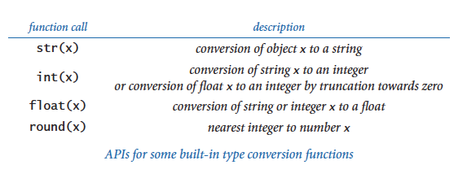
we will see about conversion .
on the image we can see the
conversion methods.
eg :
x = 123
print(x)
this will be an integer output,what if the first command we use,which is
print(str(x))
then we get an string output. we can check what type it is, with type().

Slide 48
let's use some operators inside the variables.
adding of two string
x = “hello”
y = “python” # both x and y is type string
var = x+y #this will be called concatinating of two string.
print(var)
print(type(var))
output will be: hello python
what if we add string with integer or a float value.
sure we get an error “traceback ........” some thing start with this word.

Slide 49
But we can do that by converting a string into integer and we can add them.
eg:
        x = “13345”
        y = 12345
        z = int(x)
        a = z+y
        print(a)
so by this method we can add a string to integer. But we can’t do this, which is,
x = “hello”
z = int(x) # this will be an error.
we an change an actual string into integer.

Slide 50
STRING

Slide 51
String
As we know about string anyways but a lot more about string is there.
Strings in python are surrounded by either single quotation marks, or double quotation marks.
'hello' is the same as "hello".
You can display a string literal with the print() function:
Print(‘hello’)
Print(“hello”)
output :
hello
hello

Slide 52
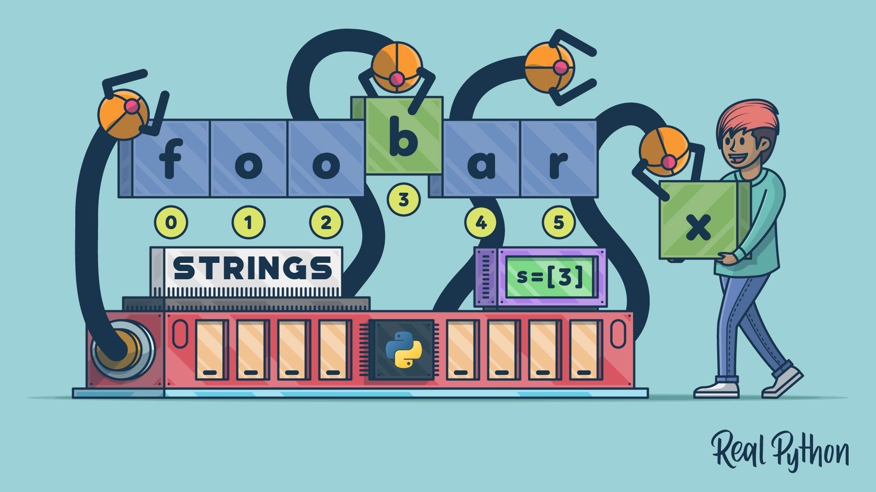
String as array
Like many other popular programming languages, strings in Python are arrays of bytes representing unicode characters.
However, Python does not have a character data type, a single character is simply a string with a length of 1.
Square brackets can be used to access elements of the string.
Which is:
X = “array”
Print(X[0])
The output will be:
a
That is , in python number starts from 0.(0,1,2,3,4,5,6,….)

Slide 53
To get the length of the string we use a function called len().
X = “hello programmer”
Print(len(X))
To check if a certain phrase or character is present in a string, we can use the keyword in.
Text = “hello,let’s start coding”
Print(“start” in Text)
In the above code, the output will be a boolean value.which is true or false.
The above output will be true.

Slide 54
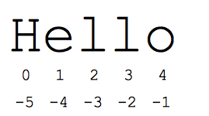
We can check with the if statement too. That will be studied in future lessons.
To check if a certain phrase or character is NOT present in a string, we can use the keyword not in.
Voice = “this is an automated voice by siri”
Print(“hello” not in Voice)
Yes, the output will be “true”.
PYTHON- SLICING
It’s the important topic in string. We deal with these a lot in python programming.
You can return a range of characters by using the slice syntax.
Specify the start index and the end index, separated by a colon, to return a part of the string.
The syntax of string slicing is :
[start:stop:step]

Slide 55
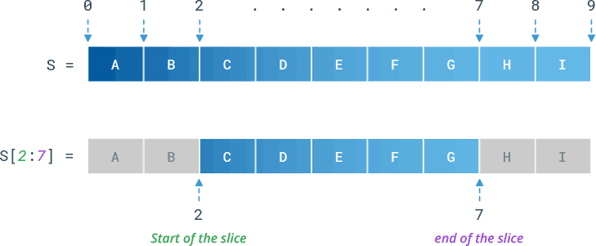
Eg:
xyz = “hy my name is python”
Print(xyz[2:10])
Output:
My name
Explanation: here they start counting from 0 and they count spaces also .
So they start print from the space before the word “my”.
And stops at “name” because python never prints end value, which is space in this case.
Eg 2:
By leaving out the end index, the range will go to the end:
word = “hello python”
Print(word[1:])

Slide 56
Output:
llo python
We can index them with negative index. Which is reverse order.
Python will not calculate with 0, when we come from reverse.
Ie;
x = “python”
Print(x[-1])
Output:
n
We can use negative indexes to start the slice from the end of the string:
Eg :
b = "Hello, World!"
print(b[-5:-2])
Output:
Orl

Slide 57
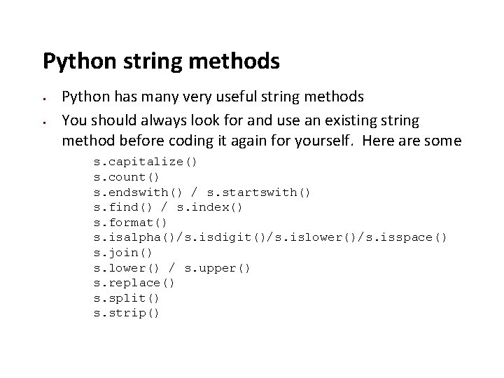
From: "o" in "World!" (position -5)
To, but not included: "d" in "World!" (position -2)
Python has a set of built-in methods that you can use on
strings.
We can make a string word all uppercase and lowercase.
For uppercase we use upper() function. And lower() function to lower case.
Eg:
Word = “hello python”
Print(Word.upper())
Output: HELLO PYTHON

Slide 58
Eg: word = “HELLO PYTHON”
Print(word.lower())
Output: hello python
We can remove white space with a strip() function.Whitespace is the space before and/or after the actual text, and very often you want to remove this space.
Eg:
a = " Hello, World! "
  print(a.strip()) # returns "Hello, World!"
  We can replace a letter in a string by replace() function.
Eg:
a = "Hello, World!"
print(a.replace("H", "J"))

Slide 59
The split() method returns a list where the text between the specified separator becomes the list items.
a = "Hello, World!"
print(a.split(“,”)) # returns ['Hello', ' World!']
Concatenation
We can use + operator to combine, or concatenation.
A = “hello”
B = “python”
v= A+B
Print(v)

Slide 60
String format
we cannot combine strings and numbers like this:
age = 36
txt = "My name is John, I am " + age
print(txt)
This will be an error.
There is a method where we can add string to a number, that is format() function.
The format() method takes the passed arguments, formats them, and places them in the string where the placeholders {} are:
age = 36
txt = "My name is John, and I am {}"
print(txt.format(age))

Slide 61
The format() method takes unlimited number of arguments, and are placed into the respective placeholders:
amount= 3212
orderno= 4776
quantity= 10
myorder = "I want {} of my order{} for {} rupees."
print(myorder.format(quantity,orderno,amount))

Slide 62
Escape Character
To insert characters that are illegal in a string, use an escape character.
An escape character is a backslash \ followed by the character you want to insert.
txt = "We are the so-called \"Vikings\" from the north."
Print(txt)
Output: We are the so called “vikings” from the north.

Slide 63
Code | Result
\' | Single Quote
\\ | Backslash
\n | New Line
\r | Carriage Return
\t | Tab
\b | Backspace
\f | Form Feed
\ooo | Octal value
\xhh | Hex value
The above table represents the escape character used in python language.

Slide 64
Python Booleans
Boolean represents one of the two values. Ie; True or false.
In python this boolean plays a major part which is decision making.
We will deal detailed in “if condition”.
You can evaluate any expression in Python, and get one of two answers, True or False.
When you compare two values, the expression is evaluated and Python returns the Boolean answer that is:
Print(10 ==10)
Print(10 <9)
Print(10 ==100)

Slide 65
Output :
True
False
False
We can evaluate anything with the help of bool() function.that will return either true or false.

Slide 66
Eg:
Print(bool(“hello”))
Print(bool(100))
Output :
True
True
In python almost every value is True that is:
Almost any value is evaluated to True if it has some sort of content.
Any string is True, except empty strings.
Any number is True, except 0.
Any list, tuple, set, and dictionary are True, except empty ones.
Print(bool("python"))
print(bool(100))
print(bool(["apple", "cherry", "banana"]))

Slide 67
Some will be False:
There are not many values that evaluate to False, except empty values, such as (), [], {}, "", the number 0, and the value None. And of course the value False evaluates to False.
bool(False)
bool(None)
bool(0)
bool(())
bool([])

Slide 68
We will get one more false value in return which is an object from a class with a __len__ function that returns 0 or False. We discuss this in class and object section.
We can create function which can give return an boolean value,
Eg:
def myFunction() :
return True
if myFunction():
print("YES!")
else:
print("NO!")

Slide 69
The above program will be a function we will discuss this in function section.
Python also has many built-in functions that return a boolean value, like the isinstance() function, which can be used to determine if an object is of a certain data type:
x = 200
print(isinstance(x, int))
The above code represents, if x has an integer value it will print true otherwise it will be false. In this case it will be True.

Slide 70
OPERATORS

Slide 71
Python operators
Operators are special symbols that perform some operation on operands and returns the result. For example, 5 + 6 is an expression where + is an operator that performs arithmetic add operation on numeric left operand 5 and the right side operand 6 and returns a sum of two operands as a result.
Python divides the operators in the following groups:
1.Arithmetic operators
2.Assignment operators
3.Comparison operators
4.Logical operators
5.Identity operators
6.Membership operators
7.Bitwise operators

Slide 72
1.Arithmetic Operators
Arithmetic operators perform the common mathematical operation on the numeric operands.
The arithmetic operators return the type of result depends on the type of operands, as below.
If either operand is a complex number, the result is converted to complex;
If either operand is a floating point number, the result is converted to floating point;
If both operands are integers, then the result is an integer and no conversion is needed.

Slide 73
The following table lists all the arithmetic operators in Python:
Operation | Operator | Function | Example in Python Shell
Addition: Sum of two operands | + | operator.add(a,b) | >>> x = 5; y = 6 >>> x + y11 >>> import operator >>> operator.add(5,6) 11
Subtraction: Left operand minus right operand | - | operator.sub(a,b) | >>> x = 10; y = 5 >>> x - y5 >>> import operator >>> operator.sub(10, 5) 5
Multiplication | * | operator.mul(a,b) | >>> x = 5; y = 6 >>> x * y 30 >>> import operator >>> operator.mul(5,6) 30
Exponentiation: Left operand raised to the power of right | ** | operator.pow(a,b) | >>> x = 2; y = 3 >>> x ** y 8 >>> import operator >>> operator.pow(2, 3) 8
Division | / | operator.truediv(a,b) | >>> x = 6; y = 3 >>> x / y 2 >>> import operator >>>operator.truediv(6, 3) 2
Floor division: Equivilant to math.floor(a/b) | // | operator.floordiv(a,b) | >>> x = 6; y = 5 >>> x // y 1 >>> import operator >>>operator.floordiv(6,5) 1
Modulus: Reminder of a/b | % | operator.mod(a, b) | >>> x = 11; y = 3 >>> x % y 2 >>> import Operator >>> operator.mod(11, 3) 2

Slide 74
2.Assignment operator
The assignment operators are used to assign values to variables. The following table lists all the arithmetic operators in Python:
Operator | Function | Example in Python Shell
= |  | >>> x = 5; >>> x 5
+= | operator.iadd(a,b) | >>> x = 5 >>> x += 5 10 >>> import operator >>> x = operator.iadd(5, 5) 10
-= | operator.isub(a,b) | >>> x = 5 >>> x -= 2 3 >>> import operator >>> x = operator.isub(5,2) 3

Slide 75
*= | operator.imul(a,b) | >>> x = 2 >>> x *= 3 6 >>> import operator >>> x = operator.imul(2, 3) 6
/= | operator.itruediv(a,b) | >>> x = 6 >>> x /= 3 2 >>> import operator >>> x = operator.itruediv(6, 3) 2
//= | operator.ifloordiv(a,b) | >>> x = 6 >>> x //= 5 1 >>> import operator >>> operator.ifloordiv(6,5) 1
%= | operator.imod(a, b) | >>> x = 11 >>> x %= 3 2 >>> import operator >>> operator.imod(11, 3) 2
&= | operator.iand(a, b) | >>> x = 11 >>> x &= 3 1 >>> import operator >>> operator.iand(11, 3) 1

Slide 76
|= | operator.ior(a, b) | >>> x = 3 >>> x |= 4 7 >>> import operator >>> operator.mod(3, 4) 7
^= | operator.ixor(a, b) | >>> x = 5 >>> x ^= 2 7 >>> import operator >>> operator.ixor(5, 2) 7
>>= | operator.irshift(a, b) | >>> x = 5 >>> x >>= 2 1 >>> import operator >>> operator.irshift(5, 2) 1
<<= | operator.ilshift(a, b) | >>> x = 5 >>> x <<= 2 20 >>> import operator >>> operator.ilshift(5, 2) 20

Slide 77
Logical Operators
The logical operators are used to combine two boolean expressions. The logical operations are generally applicable to all objects, and support truth tests, identity tests, and boolean operations.
Operator | Description | Example
and | True if both are true | >>> x = 5; y = 6 >>> x > 1 and y <10 True
or | True if at least one is true | >>> x = 5; y = 6 >>> x > 6 or y <10 True
not | Returns True if an expression evalutes to false and vice-versa | >>> x = 5 >>> not x > 1 False

Slide 78
● Identity Operators
The identity operators check whether the two objects have the same id value that is, both the objects point to the same memory location.
Operator | Function | Description | Example in Python Shell
is | operator.is_(a,b) | True if both are true | >>> x = 5; y = 6 >>> x is y False >>> import operator >>>operator.is_(x,y) False
is not | operator.is_not(a,b) | True if at least one is true | >>> x = 5; y = 6 >>> x is not y True >>> import operator >>>operator.is_not(x, y) True

Slide 79
● Membership Test Operators
The membership test operators in and not in test whether the sequence has a given item or not. For the string and bytes types, x in y is True if and only if x is a substring of y.

Slide 80
Operator | Function | Description | Example in Python Shell
in | operator.contains(a,b) | Returns True if the sequence contains the specified item else returns False. | >>> nums = [1,2,3,4,5] >>> 1 in nums True >>> 10 in nums False >>> 'str' in 'string' True >>> import operator >>> operator.contains(nums, 2) True
not in | not operator.contains(a,b) | Returns True if the sequence does not contains the specified item, else returns False. | >>> nums = [1,2,3,4,5] >>> 1 not in nums False >>> 10 not in nums True >>> 'str' not in 'string' False >>> import operator >>> not operator.contains(nums, 2) False

Slide 81
● Bitwise Operators
Bitwise operators perform operations on binary operands.

Slide 82
Operator | Function | Description | Example in Python Shell
& | operator.and_(a,b) | Sets each bit to 1 if both bits are 1. | >>> x=5; y=10 >>> z=x & y >>> z 0 >>> import operator >>> operator.and_(x, y) 0
| | operator.or_(a,b) | Sets each bit to 1 if one of two bits is 1. | >>> x=5; y=10 >>> z=x | y >>> z 15 >>> import operator >>> operator.or_(x, y) 15
^ | operator.xor(a,b) | Sets each bit to 1 if only one of two bits is 1. | >>> x=5; y=10 >>> z=x ^ y >>> z 15 >>> import operator >>> operator.xor(x, y) 15

Slide 83
LISTS

Slide 84
● LISTS The list is a mutable sequence type. A list object contains one or more items of different data types in the square brackets [] separated by a comma. Lists are used to store multiple values.Lists are one of 4 built-in data types in Python used to store collections of data.
Eg: fruits = [“banana”,”apple”,”orange”]
Print(fruits)
In the above example fruits is a list which contain multiple values. List items are ordered, changeable, and allow duplicate values. List items are indexed, the first item has index [0], the second item has index [1] etc.

Slide 85
When we say that lists are ordered, it means that the items have a defined order, and that order will not change.
If you add new items to a list, the new items will be placed at the end of the list.
There are some list methods that will change the order, but in general: the order of the items will not change.
The list is changeable,that is we can add, remove items in a list after it is created.
List are indexed ,which means it can have same values as many times .
Eg:
Fruits = [“apple”,”orange”,”mango”,”apple”]
Print(Fruits)

Slide 86
Accessing a item in list, which is so simple, we just need to index the list number to acess that item.
Print(Fruits[1])
The output of this code will be : orange
Negative indexing means start from the end
-1 refers to the last item, -2 refers to the second last item etc.
Print(Fruits[-1])
The output will be : apple
The negative starts from -1.

Slide 87
● RANGE OF ITEMS We can specify a range of indexes by specifying where to start and where to end the range. When specifying a range, the return value will be a new list with the specified items.
Fruits =[“apple”,”orange”,”mango”,”apple”,”kiwi”,”pineapple”]
Print(Fruits[1:5])
Here the output will be from range orange to kiwi.
Output will starts from orange[1], and end with kiwi[4], ie; [5] will not be printed. Remember that the first item has index 0.

Slide 88
When we didn’t put the start value , but we defined end value then we get output from the start likewise we defined start value then we get whole list till end .
Eg:
Print(Fruits[:5])
Print(Fruits[1:])
We can change the values inside the list by indexing .
Fruits[1] = “banana”
Print(Fruits)
This will print with banana,which has index [1].

Slide 89
. What if we need to change the range of list.
To change the value of items within a specific range, define a list with the new values, and refer to the range of index numbers where you want to insert the new values:
Fruits[2:4]= [“watermelon”,”green apple”]
Print(Fruits)
Output:
[“apple”,”banana”,”watermelon”,”green apple”,”kiwi”,”pineapple”]
If we insert more items than you replace, the new items will be inserted where we specified, and the remaining items will move accordingly:
Fruits = [‘apple’,’banana’,’orange’]
Fruits[2:] = [‘watermelon’,’kiwi’]
Print(Fruits)

Slide 90
Output:
[‘apple’,’banana’,’watermelon’,’kiwi’]
When we change items like the above code, then the length of the list will be change.
If we insert less items than you replace, the new items will be inserted where we specified, and the remaining items will move accordingly
Fruits = [‘apple’,’banana’,’orange’]
Fruits[1:2] = [’kiwi’]
Print(“Fruits”)
Output:[‘apple’,’kiwi’]
. We can insert a new item by using Insert() function.
Fruits = ["apple", "banana", "cherry"]
Fruits .insert(1, "orange")
print(Fruits )

Slide 91
Output:
[“apple”,”orange”,”banana”,”cherry”]
We can add an item using append() function too.
Fruits = ["apple", "banana", "cherry"]
Fruits .append("orange")
Prinr(Fruits)
But in this method we cant specify the index, so it will be in the last of the list.
To append elements from another list to the current list, use the extend() method.
Fruits = ["apple", "banana", "cherry"]
fruits2 = ["mango", "pineapple", "papaya"]
Fruits .extend(fruits2 )
print(Fruits )
This extend() function has a specialty which is it can append elements not only from list, it can be used when there is a tuple or an set.

Slide 92
Ie; Fruits = ["apple", "banana", "cherry"]
fruits2 = ("mango", "pineapple", "papaya") #this one is tupple.
Fruits .extend(fruits2 )
Print(Fruits)
Now we can add or change the items in list.But how we delete them or remove them.
We can by --> remove() , pop() , del(), clear() functions. With help of these functions we can delete list items.
Remove() --> Fruits = ["apple", "banana", "cherry"]
Fruits.remove(“apple”)
Print(Fruits)

Slide 93
Pop() ----> Fruits = ["apple", "banana", "cherry"]
fruits.pop(1)
Print(Fruits)
del() -----> Fruits = ["apple", "banana", "cherry"]
del Fruits[1]
Print(Fruits)
del() function can be used to delete the whole list.
Fruits = ["apple", "banana", "cherry"]
del Fruits

Slide 94
Then, there comes clear() function, we can clear the list with this function, without deleting the list that is list will be there, but has no content.
Fruits = ["apple", "banana", "cherry"]
Fruits.clear()
Print(“fruits”)
Copying of a list--->
You cannot copy a list simply by typing list2 = list1, because: list2 will only be a reference to list1, and changes made in list1 will automatically also be made in list2.
There are ways to make a copy, one way is to use the built-in List method copy()
Fruits = ["apple", "banana", "cherry"]
myfruits = thislist.copy()
print(myfruits)

Slide 95
Method | Description
append() | Adds an element at the end of the list
clear() | Removes all the elements from the list
copy() | Returns a copy of the list
count() | Returns the number of elements with the specified value
extend() | Add the elements of a list (or any iterable), to the end of the current list
index() | Returns the index of the first element with the specified value
insert() | Adds an element at the specified position
pop() | Removes the element at the specified position
remove() | Removes the item with the specified value
reverse() | Reverses the order of the list
sort() | Sorts the list

Slide 96
TUPLES

Slide 97
Tuples
Tuples are just same as the list, which is used to store multiple value.
Tuple is one of 4 built-in data types in Python used to store collections of data.It is a collection of data which is ordered, and unchangeable.
Tuples start and end with round brackets.
Fruits=(“apple”,”orange”,”kiwi”)
Print(Fruits)
Tuples allow duplicate items , as lists tuples items are also indexed and as same as list this is called by [0],[1] and so on.
These are unchangeable that is we cannot add or remove items after the creation of tuple.

Slide 98
We can create a tuple with only one item. An in tuple same as list it will created as we declared the items in it.
Fruits=(“apple”,”orange”,”kiwi”)
Print(Fruits)
And to find length we use len() function.
Fruits=(“apple”,”orange”,”kiwi”)
Print(len(Fruits))
We can input variety of datatypes in a tuple. String, int and boolean.
Variety = ("abc", 34, True, 40, "male")

Slide 99
We can input variety of datatypes in a tuple. String, int and boolean.
Variety = ("abc", 34, True, 40, "male")
From Python's perspective, tuples are defined as objects with the data type 'tuple' which is <class ‘tuple’>
Fruits=(“apple”,”orange”,”kiwi”)
Print(type(Fruits))
Accessing an item in tuple is just like we access in list, we need to specify the index of the item we need to get.
Fruits= ("apple", "banana", "cherry")
print(Fruits[1])

Slide 100
As like the list we can negative index them too.
Fruits= ("apple", "banana", "cherry")
print(Fruits[-1])
As mentioned we can get items from the given range.
Fruits = ("apple", "banana", "cherry", "orange", "kiwi", "melon")
print(Fruits[2:])

Slide 101
As earlier we said tuple are unchangeable, which is true, but we can change tuple to list and change items and return it to tuple.
Once a tuple is created, you cannot change its values. Tuples are unchangeable, or immutable as it also is called.
But there is a workaround. You can convert the tuple into a list, change the list, and convert the list back into a tuple.
x = ("apple", "banana", "cherry")
y = list(x)
y[1] = "watermelon"
x = tuple(y)
print(x)
We can use the append or insert function once we change tuple into list.
And we can use remove and pop function too.

Slide 102
When we assign some values in tuple ,it will be created that is also called packing.
fruits = ("apple", "banana", "cherry")
In python we can unpack this packed values,that is
We can extract the packed values ,this is called unpacking.
fruits = ("apple", "banana", "cherry")
(green, yellow, red) = fruits
print(green)
print(yellow)
print(red)
The above methods can be used in tuples.
Method | Description
count() | Returns the number of times a specified value occurs in a tuple
index() | Searches the tuple for a specified value and returns the position of where it was found

Slide 103
SETS

Slide 104
Sets
These are just like above both , used to store multiple values. Sets are unordered,unindexed,unchangeable and it will not allow duplicates. A set is a collection which is both unordered and unindexed.
Sets are written with curly brackets.
fruits= {"apple", "banana", "cherry"}
print(fruits)
Just like the others here also we can find the length of a set and we can find the type and same as others it have constructor.
Because of Unindexed we can't call like list or tuple.
We need to loop it ,by using for.

Slide 105
Fruits = {"apple", "banana", "cherry"}
for x in Fruits :
print(x)
X goes through the set and print that value, we will discuss it further more on future class.
We can check if that value is present or what.
Print(“banana” in Fruits)
We can add items in the set by add() and update() function.
Add()
fruits= {"apple", "banana", "cherry"}
fruits.add("orange")
print(fruits)

Slide 106
Update()--> we can merge list or tuple with set using this function.
fruits= {"apple", "banana", "cherry"}
mylist = ["kiwi", "orange"]
fruits.update(mylist)
print(fruits)
Remove an item in a set, use the remove(), or the discard() method.
fruits= {"apple", "banana", "cherry"}
fruits.remove("banana")
print(fruits)
fruits= {"apple", "banana", "cherry"}
fruits.discard("banana")
print(fruits)

Slide 107
We can use pop(), del(),clear().
fruits= {"apple", "banana", "cherry"}
fruits.clear()
print(fruits)
fruits= {"apple", "banana", "cherry"}
del fruits
print(fruits)
fruits= {"apple", "banana", "cherry"}
x = fruits.pop()
print(x)
print(fruits)

Slide 108
In math we all studied union ,intersection and all that will implement here, for joining sets.
Union() function
The union() method returns a new set with all items from both sets
set1 = {"a", "b" , "c"}
set2 = {1, 2, 3}
set3 = set1.union(set2)
print(set3)
Update()
set1 = {"a", "b" , "c"}
set2 = {1, 2, 3}
set1.update(set2)
print(set1)
Both union() and update() will exclude any duplicate items.

Slide 109
The intersection_update() method will keep only the items that are present in both sets.
x = {"apple", "banana", "cherry"}
y = {"google", "microsoft", "apple"}
x.intersection_update(y)
print(x)
The intersection() method will return a new set, that only contains the items that are present in both sets.
x = {"apple", "banana", "cherry"}
y = {"google", "microsoft", "apple"}
z = x.intersection(y)
print(z)

Slide 110
The symmetric_difference_update() method will keep only the elements that are NOT present in both sets.
x = {"apple", "banana", "cherry"}
y = {"google", "microsoft", "apple"}
x.symmetric_difference_update(y)
print(x)
The symmetric_difference() method will return a new set, that contains only the elements that are NOT present in both sets.
x = {"apple", "banana", "cherry"}
y = {"google", "microsoft", "apple"}
z = x.symmetric_difference(y)
print(z)

Slide 111
Method | Description
add() | Adds an element to the set
clear() | Removes all the elements from the set
copy() | Returns a copy of the set
difference() | Returns a set containing the difference between two or more sets
difference_update() | Removes the items in this set that are also included in another, specified set
discard() | Remove the specified item
intersection | Returns a set, that is the intersection of two other sets
itersection_update | Removes the items in this set that are not present in other, specified set(s)

Slide 112
isdisjoint() | Returns whether two sets have a intersection or not
issubset() | Returns whether another set contains this set or not
issuperset() | Returns whether this set contains another set or not
pop() | Removes an element from the set
remove() | Removes the specified element
symmetric_difference() | Returns a set with the symmetric differences of two sets
symmetric_difference_update() | inserts the symmetric differences from this set and another
union() | Return a set containing the union of sets
update() | Update the set with the union of this set and others

Slide 113
FROZENSET

Slide 114
The frozenset() is an inbuilt function in Python which takes an iterable object as input and makes them immutable. Simply it freezes the iterable objects and makes them unchangeable.
In Python, frozenset is the same as set except the frozensets are immutable which means that elements from the frozenset cannot be added or removed once created. This function takes input as any iterable object and converts them into an immutable object. The order of elements is not guaranteed to be preserved.
Syntax : frozenset(iterable_object_name)
EG:
nu = (1, 2, 3, 4, 5, 6, 7, 8, 9) # tuple of numbers
fnum = frozenset(nu) # converting tuple to frozenset
print("frozenset Object is : ", fnum) # printing details
Output:
frozenset Object is : frozenset({1, 2, 3, 4, 5, 6, 7, 8, 9})

Slide 115
DICTIONARIES

Slide 116
Dictionaries
Dictionaries are like the other ,it is used to store multiple value. But unlike other these store values in key- value pair.
Dictionaries are written with curly brackets, and have keys and values
As of Python version 3.7, dictionaries are ordered. In Python 3.6 and earlier, dictionaries are unordered.
A dictionary is a collection which is ordered*, changeable and does not allow duplicates.
cars= {
"brand": "BNW",
"model": "2nd series",
"year": 2004
}
print(cars)

Slide 117
Dictionary items are ordered, changeable, and does not allow duplicates.
Dictionary items are presented in key:value pairs, and can be referred to by using the key name.
Like others we can get length and type in this dict.
And can store different types of data.
1.Accessing an item in dict is easy as list and tuple .here we can call a list by using its key because it is stored in a key value pair.
If we need the model of cars then,
Print(cars[‘model’])
We can use get method for accessing the values.
Ie; x = cars.get(“model”)
Print(x)

Slide 118
2.The keys() method will return a list of all the keys in the dictionary.
x = thisdict.keys()
Print(x)
3.The values() method will return a list of all the values in the dictionary.
x = thisdict.values()
Print(x)
The list of the values is a view of the dictionary, meaning that any changes done to the dictionary will be reflected in the values list.
car = {
"brand": "Ford",
"model": "Mustang",
"year": 1964
}
x = car.values()
print(x) #before the change
car["year"] = 2020
print(x) #after the change

Slide 119
car = {
"brand": "Ford",
"model": "Mustang",
"year": 1964
}
x = car.values()
print(x) #before the change
car["color"] = "red" #this will be new key:value.
print(x) #after the change
4.The items() method will return each item in a dictionary, as tuples in a list.
Items is both key and value.
X = cars.items()
Print()
The returned list is a view of the items of the dictionary, meaning that any changes done to the dictionary will be reflected in the items list.

Slide 120
5.To change the dict items we just need to call the key and assign the new value. Or we can use the update() function.
car = {
"brand": "Ford",
"model": "Mustang",
"year": 1964
}
car[“year”] = 2020
Print(cars)
The above code will change the value of year (1964) to 2020.
Or we can use update() function,
cars= {
"brand": "Ford",
"model": "Mustang",
"year": 1964
}
cars.update({"year": 2020})

Slide 121
6.Next we need to remove the items in the list, that can be done by,
Pop(),popitem(),del(),clear() functions.
Car = {
"brand": "Ford",
"model": "Mustang",
"year": 1964
}
Car.pop(‘year’)
The popitem() method removes the last inserted item
cars.popitem()
Print(cars)
The del keyword removes the item with the specified key name.
del thisdict["model"]
print(thisdict)

Slide 122
The clear() method empties the dictionary.
thisdict.clear()
print(thisdict)
Copy Dictionaries
We cannot copy a dictionary simply by typing dict2 = dict1, because: dict2 will only be a reference to dict1, and changes made in dict1 will automatically also be made in dict2.
We can use copy method using function copy(). This function will not make reference of that variable instead of it will make copy.
Eg: thisdict = {
"brand": "Ford",
"model": "Mustang",
"year": 1964
}
mydict = thisdict.copy()
print(mydict)

Slide 123
We can also do this by another function called dict().
Eg:
thisdict = {
"brand": "Ford",
"model": "Mustang",
"year": 1964
}
mydict = dict(thisdict)
print(mydict)
we can also do nested dict.
we discuss with an example in the next slide.

Slide 124
Nested Dictionaries
We can add more dictionaries in one single dict. Such dictionaries is called nested dictionaries.
friends= {
"child1" : {
"name" : "arun",
"year" : 2000
},
"child2" : {
"name" : "vignesh",
"year" : 2001
},
"child3" : {
"name" : "arya",
"year" : 2018
}
}

Slide 125
Or we can also add 3 separate dictionaries into a single dictionary.
Eg:
child1 = {
"name" : "arun",
"year" : 2000
}
child2 = {
"name" : "Vignesh",
"year" : 2001
}
child3 = {
"name" : "Arya",
"year" : 2018
}
friends= {
"child1" : child1,
"child2" : child2,
"child3" : child3
}

Slide 126
Method | Description
clear() | Removes all the elements from the dictionary
copy() | Returns a copy of the dictionary
fromkeys() | Returns a dictionary with the specified keys and value
get() | Returns the value of the specified key
items() | Returns a list containing a tuple for each key value pair
keys() | Returns a list containing the dictionary's keys
pop() | Removes the element with the specified key
popitem() | Removes the last inserted key-value pair
setdefault() | Returns the value of the specified key. If the key does not exist: insert the key, with the specified value
update() | Updates the dictionary with the specified key-value pairs
values() | Returns a list of all the values in the dictionary

Slide 127
CONDITIONAL STATEMENTS

Slide 128
Python Conditions and If statements
Python supports the usual logical conditions from mathematics:
1.Equals: a == b
2.Not Equals: a != b
3.Less than: a < b
4.Less than or equal to: a <= b
5.Greater than: a > b
6.Greater than or equal to: a >= b
These conditions can be used in several ways, most commonly in "if statements" and loops.

Slide 129
An "if statement" is written by using the if keyword.
Eg:
a = 33
b = 200
if b > a:
print("b is greater than a")
In the above eg we use two variable and an operator. We use if statement to check whether it is true or not.
We say like if that is true then , print “b is greater than a”
Python runs the code and check if that is true then it will print .

Slide 130
Indentation
Indentation is the white space at the beginning of the line to define scope in the code. Other programming languages often use curly-brackets for this purpose.
Eg:
a = 33
b = 200
if b > a:
print("b is greater than a")
If we type the code like this, then we get the error message because we miss the indentation.

Slide 131
Elif
Elif says if the above condition is not true try these.
Which is it is same as if but it says 1st if condition is false then try elif to the system.
Eg: a = 33
b = 33
if b > a:
print("b is greater than a")
elif a == b:
print("a and b are equal")
If we run the above program then, python check if statement first then if that's true then it will print that statement, in this scene we get the elif statement , if is wrong and python will run elif statement.

Slide 132
Else
If all the conditions fails to meet ,then the python execute the else condition statement.
Eg :
a = 200
b = 33
if b > a:
print("b is greater than a")
elif a == b:
print("a and b are equal")
else:
print("a is greater than b")
In the above code , python will check 1st two condition and that will be false and it will execute else statement.

Slide 133
If we have only one statement to execute, we can put it on the same line as the if statement , which is called shorthand if.
Example of one line if statement.
if a > b: print("a is greater than b")
Eg :
a = 2
b = 330
print("A") if a > b else print("B")
We can also have multiple else statements on the same line:
Eg:
a = 330
b = 330
print("A") if a > b else print("=") if a == b else print("B")
We can use logical operators in if statement which is and , or.

Slide 134
And
The and keyword is a logical operator, and is used to combine conditional statements.
Eg :
a = 200
b = 33
c = 500
if a > b and c > a:
print("Both conditions are True")
The above code will execute when both the statements are true.

Slide 135
Or
The or keyword is a logical operator, and is used to combine conditional statements.
Eg:
a = 200
b = 33
c = 500
if a > b or a > c:
print("At least one of the conditions is True")
In the above code, “or” is used, which is, python will execute when one condition true.

Slide 136
Nested If
We can have if statements inside the if statement, that is called nested if.
Eg :
x = 41
if x > 10:
print("Above ten,")
if x > 20:
print("and also above 20!")
else:
print("but not above 20.")
1st python will check x>10 if that is true then it will print “above ten”.then it will come to next command, which is x > 20 , if that is true then we get “and also above 20!”.
If that both statements are false we get else statement.

Slide 137
Pass Statement
if statements cannot be empty, but if you for some reason have an if statement with no content, put in the pass statement to avoid getting an error.
Eg: a = 33
b = 200
if b > a:
pass

Slide 138
LOOPING STATEMENTS

Slide 139
While loop
In python while loop is used to execute a block of statements repeatedly until a given condition is satisfied. And when the condition becomes false, the line immediately after the loop in the program is executed. While loop falls under the category of indefinite iteration. Indefinite iteration means that the number of times the loop is executed isn’t specified explicitly in advance.
While expression:
Statements
Python uses indentation as its method of grouping statements. When a while loop is executed, expr is first evaluated in a Boolean context and if it is true, the loop body is executed. Then the expr is checked again, if it is still true then the body is executed again and this continues until the expression becomes false.

Slide 140
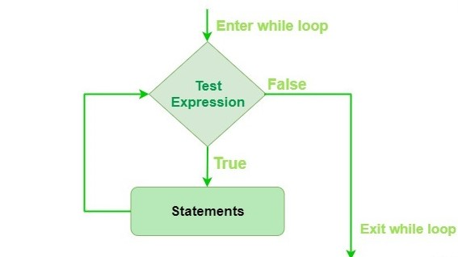
Eg:
# Python program to illustrate
# while loop
# checks if list still
# contains any element
a = [1, 2, 3, 4]
while a:
print(a.pop())
Loop control statements change execution from its normal sequence. When execution leaves a scope, all automatic objects that were created in that scope are destroyed. Python supports the following control statements.

Slide 141
Continue,Break and pass
Continue-> It allow to do while loop its itteration.It returns the control to the beginning of the loop.
I = 0
while I <4:
I += 1
print(I)
continue
This simple program will print till our condition become false.
Break --> It brings control out of the loop.
I = 0
while I <4:
I += 1
print(I)
break
This program stops the iteration after its prints the 1st value.

Slide 142
Pass Statement--> We use pass statement to write empty loops. Pass is also used for empty control statements, functions and classes.
a = 'loop in python'
i = 0
while i < len(a):
i += 1
pass
print('Value of i :', i)
Output
Value of i : 13

Slide 143
eg :Prints all letters except 'y' and '0'
i = 0
a = 'loops in python'
while i < len(a):
if a[i] == 'e' or a[i] == 's':
i += 1
continue
print('Current Letter :', a[i])
i += 1
the above program make a loop and goes through the condition. it ends when while become false and we use continue in this loop.

Slide 144
eg2:break the loop as soon it sees 'p'
i = 0
a = 'loops in python'
while i < len(a):
if a[i] == 'p' or a[i] == 'h':
i += 1
break
print('Current Letter :', a[i])
i += 1
the above program will break when it sees p or h .

Slide 145
while-else loop
while loop executes the block until a condition is satisfied. When the condition becomes false, the statement immediately after the loop is executed.
The else clause is only executed when your while condition becomes false. If you break out of the loop, or if an exception is raised, it won’t be executed.
The else block just after for/while is executed only when the loop is NOT terminated by a break statement.
i = 0
while i < 4:
i += 1
print(i)
else: # Executed because no break in for
print("No Break\n")

Slide 146
i = 0
while i < 4:
i += 1
print(i)
break
else: # Not executed as there is a break
print("No Break")
Here the else part will not work because we have a break in the loop so while stops
the looping.

Slide 147
Output:
1
2
3
4
No Break (end of 1st program)
1
For loops.
For loops, in general, are used for sequential traversal. It falls under the category
of definite iteration. Definite iterations means the number of repetitions is specified
explicitly in advance.
In python, for loops only implements the collection-based iteration.

Slide 148
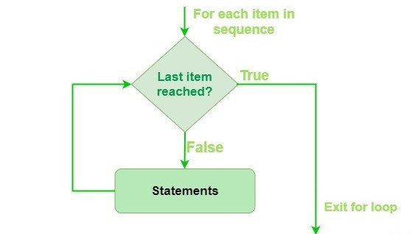
Here the iterable is a collection of objects like list, tuple. The indented statements inside the for loops are executed once for each item in an iterable. The variable var takes the value of next item of the iterable each time through the loop.
# Iterating over a list
print("List Iteration")
l = ["hello", "for", "python"]
for i in l:
print(i)
Output:
List Iteration
hello
for
python

Slide 149
# Iterating over a tuple (immutable)
print("\nTuple Iteration")
t = ("hello", "for", "python")
for i in t:
print(i)
output:
Tuple Iteration
hello
for
python

Slide 150
# Iterating over dictionary
print("\nDictionary Iteration")
d = dict()
d['xyz'] = 123
d['abc'] = 345
for i in d :
print("% s % d" %(i, d[i]))
output:
Dictionary Iteration
Xyz 123
Abc 345

Slide 151
Loop Control Statements
Loop control statements change execution from its normal sequence. When execution leaves a scope, all automatic objects that were created in that scope are destroyed. Python supports the following control statements.
Continue , break and pass
Continue--> It returns the control to the beginning of the loop.
for x in 'python developer':
if x == 'e' or x == 'o':
continue
print('Current Letter :', x)
Output will be each letter in python developer but without e and o. they continue even after that.

Slide 152
Break--> It brings control out of the loop.
for x in 'python developer':
# break the loop as soon it sees 'e' or 'o'
if x == 'o' or x == 'e':
break
print('Current Letter :', x )
Output will be ‘o’ , because it will stop looping after it sees o or e.
Pass -->We use pass statement to write empty loops. Pass is also used for empty control statements, function and classes.
for x in “python developer”:
Pass
Print(“last letter:”,x)
Output will be the last letter of the word which is ‘r’.

Slide 153
Range() function
Range() is a built-in function of Python. It is used when a user needs to perform an action for a specific number of times. The range() function is used to generate a sequence of numbers.
Range() allows user to generate a series of numbers within a given range. Depending on how many arguments user is passing to the function, user can decide where that series of numbers will begin and end as well as how big the difference will be between one number and the next.range() takes mainly three arguments.
Start--> integer starting from which the sequence of integers is to be returned
Stop--> integer before which the sequence of integers is to be returned.
The range of integers end at stop – 1.
Step--> integer value which determines the increment between each integer in the sequence

Slide 154
# show range() basics
# printing a number
for i in range(10):
print(i, end =" ")
print()
output:
0 1 2 3 4 5 6 7 8 9
# using range for iteration
l = [10, 20, 30, 40]
for i in range(len(l)):
print(l[i], end =" ")
print()

Slide 155
Output :
10 20 30 40
# performing sum of natural
# number
sum = 0
for i in range(1, 11):
sum = sum + i
print("Sum of first 10 natural number :", sum)
Output:
Sum of first 10 natural number : 55

Slide 156
In range the last stop value will not be printed , wich is in 1st example 10 is not in the output, like that.
Range syntax will be [ start, stop, step]
It will print from start and stops when it sees stop value.
3 ways we can call range:
a)range(stop) takes one argument.
b)range(start, stop) takes two arguments.
c)range(start, stop, step) takes three arguments

Slide 157
For- else loop
In most of the programming languages (C/C++, Java, etc), the use of else statement has been restricted with the if conditional statements. But Python also allows us to use the else condition with for loops.
The else block just after for/while is executed only when the loop is NOT terminated by a break statement .
for i in range(1, 4):
print(i)
else: # Executed because no break in for
print("No Break\n")
output:
1
2
3
4

Slide 158
No Break
for i in range(1, 4):
print(i)
break
else: # Not executed as there is a break
print("No Break")
1
Nested loop
A nested loop is a loop inside a loop.
The "inner loop" will be executed one time for each iteration of the "outer loop":
adj = ["red", "big", "tasty"]
fruits = ["apple", "banana", "cherry"]
for x in adj:
for y in fruits:
print(x, y)

Slide 159
Output :
red apple
red banana
red cherry
big apple
big banana
big cherry
tasty apple
tasty banana
tasty cherry

Slide 160
PYTHON FUNCTIONS

Slide 161
Python Functions
Python Functions is a block of related statements designed to perform a computational, logical, or evaluative task. The idea is to put some commonly or repeatedly done tasks together and make a function so that instead of writing the same code again and again for different inputs, we can do the function calls to reuse code contained in it over and over again.
Functions can be both built-in or user-defined. It helps the program to be concise, non-repetitive, and organized.

Slide 162
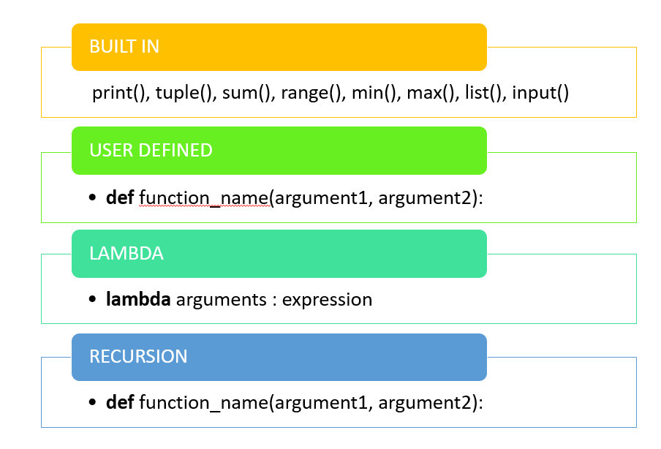
syntax
def function_name(parameters):
"""docstring"""
statement(s)
return expression
Creating a function in python is very easy, which is we need to
use “def” keyword.
eg:
def hello():
print(“Welcome to ipcs”)
After def keyword comes the function name, which is “hello()”.

Slide 163
calling a function
After creating a function we can call it by using the name of the function followed by parenthesis containing parameters of that particular function.
eg:
# A simple Python function
  def hello():
  print("Welcome to ipcs")
  # Driver code to call a function
  hello()
  Output
  Welcome to ipcs

Slide 164
Arguments of a Function
Arguments are the values passed inside the parentheses of the function. A function can have any number of arguments separated by a comma.
eg :
# A simple Python function to check
# whether x is even or odd
def evenOrodd(x):
if (x % 2 == 0):
print("even")
else:
print("odd")
# Driver code to call the function
evenOrodd(6)
evenOrodd(7)

Slide 165
Output
even
odd
The above program shows that how we can call the function. and that was to find the given number is even or odd.
The terms parameter and argument can be used for the same thing: information that are passed into a function.
From a function's perspective:
A parameter is the variable listed inside the parentheses in the function definition.
An argument is the value that is sent to the function when it is called.
Types of Arguments
Python supports various types of arguments that can be passed at the time of the function call. Let’s discuss each type in detail.
default arguments-->
A default argument is a parameter that assumes a default value if a value is not provided in the function call for that argument.

Slide 166
eg : # Python program to demonstrate default arguments
def myFun(x, y=50):
print("x: ", x)
print("y: ", y)
# Driver code (We call myFun() with only argument)
myFun(10)
Output
('x: ', 10)
('y: ', 50)
Keyword arguments-->
The idea is to allow the caller to specify the argument name with values so that caller does not need to remember the order of parameters.

Slide 167
eg : # Python program to demonstrate Keyword Arguments
def student(firstname, lastname):
print(firstname, lastname)
# Keyword arguments
student(firstname='python', lastname='functions')
student(lastname='hello', firstname='programmers')
Output:
('python', 'functions')
('hello', 'programmers')
If we try to call the function with 1 or 3 arguments, you will get an error.

Slide 168
Arbitrary Arguments, *args
In Python, we can pass a variable number of arguments to a function using special symbols.
we do not know how many arguments that will be passed into our function, add a * before the parameter name in the function definition.
This way the function will receive a tuple of arguments, and can access the items accordingly:
eg1:
def my_function(*kids):
print("The youngest child is " + kids[2])
my_function("Emil", "Tobias", "Linus")
output:
The youngest child is Linus

Slide 169
eg2:
def myfunction(*argv):
for x in argv:
print(x)
myfunction('Hello', 'Welcome', 'to', 'ipcs')
output:
Hello
Welcome
to
ipcs

Slide 170
Arbitrary Keyword Arguments, **kwargs
we do not know how many keyword arguments that will be passed into our function, add two asterisk: ** before the parameter name in the function definition.
This way the function will receive a dictionary of arguments, and can access the items accordingly:
eg1:
def my_function(**student):
print("His first name is " + student["fname"])
my_function(fname = "vignesh", lname = "s")
output: His first name is vignesh.
eg 2:
def myFun(**kwargs):
for key, value in kwargs.items():
print("%s == %s" % (key, value))
myFun(first='welcome', mid='for', last='course')

Slide 171
Output
first == welcome
mid == for
last == course
Default Parameter Value
If we call the function without argument, it uses the default value:
eg:
def my_function(country = "Norway"):
print("I am from " + country)
my_function("Sweden")
my_function("India")
my_function()
my_function("Brazil")

Slide 172
output:
I am from Sweden
I am from India
I am from Norway
I am from Brazil
Passing a List as an Argument
we can send any data types of argument to a function (string, number, list, dictionary etc.), and it will be treated as the same data type inside the function.
E.g. if we send a List as an argument, it will still be a List when it reaches the function:
def my_function(xyz):
for x in xyz:
print(x)
fruits = ["apple", "banana", "cherry"]
my_function(fruits)
output:
apple
banana
cherry

Slide 173
Return Values
The function return statement is used to exit from a function and go back to the function caller and return the specified value or data item to the caller.
Syntax: return [expression_list]
The return statement can consist of a variable, an expression, or a constant which is returned to the end of the function execution. If none of the above is present with the return statement a None object is returned.
eg:
def square_value(num):
return num**2 # This function returns the square value of the entered number.
print(square_value(2))
print(square_value(-4))
output:
4
16

Slide 174
Is Python Function Pass by Reference or pass by value?
In Python every variable name is a reference. When we pass a variable to a function, a new reference to the object is created. Parameter passing in Python is the same as reference passing in Java.
eg :
def myfunction(x):
x[0] = 30
# Driver Code (Note that lst is modified after function call.)
lst = [9, 11, 13, 14, 15]
myfunction(lst)
print(lst)
output:
[30, 11, 13, 14, 15]
#geekfunction

Slide 175
Function within Functions
A function that is defined inside another function is known as the inner function or nested function. Nested functions are able to access variables of the enclosing scope. Inner functions are used so that they can be protected from everything happening outside the function.
eg:
def f1():
s = 'I love python'I
def f2():
print(s)
f2()
# Driver's code
f1()
output:
I love python

Slide 176
python lambda
In Python, anonymous function means that a function is without a name. As we already know that def keyword is used to define the normal functions and the lambda keyword is used to create anonymous functions.
Syntax:
lambda arguments : expression
This function can have any number of arguments but only one expression, which is evaluated and returned.
One is free to use lambda functions wherever function objects are required.
You need to keep in your knowledge that lambda functions are syntactically restricted to a single expression.
It has various uses in particular fields of programming besides other types of expressions in functions.

Slide 177
eg1:
# Python program to demonstrate
# lambda functions
string ='hello python'
# lambda returns a function object
print(lambda string : string)
Output:
<function <lambda> at 0x7f268eb16f28>
in the above example1,the lambda is not being called by the print function but simply returning the function object and the memory location where it is stored.
So, to make the print to print the string first we need to call the lambda so that the string will get pass the print.

Slide 178
eg2:
x ="hello python"
# lambda gets pass to print
(lambda x : print(x))(x)
output:
hello python
Difference between lambda and normal function call
def cube(y):
return y*y*y;
g = lambda x: x*x*x
print(g(7))
print(cube(5))
output:
343
125

Slide 179
eg3:
def power(n):
return lambda a : a ** n
base = power(2) # base = lambda a : a**2 get,# returned to base
print("Now power is set to 2") # when calling base it gets executed with already set with 2
print("6 powerof 2 = ", base(6))
# returned to base
base = power(5)# base = lambda a : a**5 get
print("Now power is set to 5")# when calling base it gets executed with already set with newly 2
print("8 powerof 5 = ", base(8))
output:
Now power is set to 2
6 powerof 2 = 36
Now power is set to 5
8 powerof 5 = 32768

Slide 180
We can also replace list comprehension with Lambda by using a map() method, not only it is a fast but efficient too and let’s also see how to use lambda in the filter().
eg:
a = [100, 2, 8, 60, 5, 4, 3, 31, 10, 11]
# in filter either we use assignment or conditional operator, the pass actual parameter will get return
filtered = filter (lambda x: x % 2 == 0, a)
print(list(filtered))
# in map either we use assignment or conditional operator, the result of the value will get returned
maped = map (lambda x: x % 2 == 0, a)
print(list(maped))

Slide 181
output:
[100, 2, 8, 60, 4, 10]
[True, True, True, True, False, True, False, False, True, False]

Slide 182
Global and Local variables
Global variables are the one that is defined and declared outside a function and we need to use them inside a function.
eg:
def myfunction():
print(s)
# Global scope
s = "I love python"
myfunction()
In the above example, the function uses the global variable s. we can call s in any function, that is a global variable.
output:
I love python

Slide 183
eg2:
def myfunction():
s = "Me too."
print(s)
# Global scope
s = "I love python"
myfunction()
print(s)
In the above example, function is called first therefore local variable will be excutued, which is “me too”. then global variable is called ,so “i love python”.
output:
me too
I love python

Slide 184
eg3:
a = 1
def f():
print('Inside f() : ', a) # Uses global because there is no local 'a'
def g():
a = 2 # Variable 'a' is redefined as a local
print('Inside g() : ', a)
def h():
global a # Uses global keyword to modify global 'a'
a = 3
print('Inside h() : ', a)
print('global : ',a) # Global scope
f()
print('global : ',a)
g()
print('global : ',a)
h()
print('global : ',a)

Slide 185
In the above example, we use global variable,Any variable which is
changed or created inside of a function is local if it hasn’t been
declared as a global variable. To tell Python, that we want to use the
global variable, we have to use the keyword “global”.
in the 1st function f() , we using global variable a, which has value of 1.
and in the 2nd function g(), we declare a local variable.
and in the 3rd function h(), we change the value of global variable,
which will be 3 , therefore we get 3 when we call global variable at last.

Slide 186
First Class functions in Python
First class objects in a language are handled uniformly throughout. They may be stored in data structures, passed as arguments, or used in control structures. A programming language is said to support first-class functions if it treats functions as first-class objects. Python supports the concept of First Class functions.
Properties of first class functions:
A function is an instance of the Object type.
You can store the function in a variable.
You can pass the function as a parameter to another function.
You can return the function from a function.
You can store them in data structures such as hash tables, lists, …

Slide 187
1. Functions are objects: Python functions are first class objects. In the example below, we
are assigning function to a variable. This assignment doesn’t call the function. It takes the
function object referenced by shout and creates a second name pointing to it, yell.
def shout(text):
return text.upper()
print (shout('Hello'))
yell = shout
print (yell('Hello'))
output:
HELLO
HELLO

Slide 188
2. Functions can be passed as arguments to other functions: Because functions are objects we can pass them as arguments to other functions. Functions that can accept other functions as arguments are also called higher-order functions. In the example below, we have created a function greet which takes a function as an argument.
def shout(text):
return text.upper()
def whisper(text):
return text.lower()
def greet(func):
greeting = func("""Hi, I am created by a function
passed as an argument.""") # storing the function in a variable
print (greeting)
greet(shout)
greet(whisper)

Slide 189
3. Functions can return another function:
Because functions are objects we can return a function from another function. In the below example, the create_adder function returns
adder function.
def create_adder(x):
def adder(y):
return x+y
return adder
add_15 = create_adder(15)
print (add_15(10))
output:
25

Slide 190
Recursive Functions
What is recursion in Python?
Recursion is the process of defining something in terms of itself. A physical world example
would be to place two parallel mirrors facing each other. Any object in between them would
be reflected recursively.
Python Recursive Function
We know that in Python, a function can call other functions. It is even possible for the
function to call itself. These type of construct are termed as recursive functions. Following is
an example of a recursive function to find the factorial of an integer. Factorial of a number is
the product of all the integers from 1 to that number. For example, the factorial of 5
(denoted as 5!) is 1*2*3*4*5 = 120.

Slide 191
Example:
def calc_factorial(x):
<em>"""This is a recursive function
to find the factorial of an integer"""
</em>if x == 1:
return 1
else:
return (x * calc_factorial(x-1))
num = 4
print("The factorial of", num, "is", calc_factorial(num))

Slide 192
In the above example, calc_factorial() is a recursive function as it calls itself. When we call this function with a positive integer, it will recursively call itself by decreasing the number. Each function call multiples the number with the factorial of number 1 until the number is equal to one. Our recursion ends when the number reduces to 1. This is called the base condition. Every recursive function must have a base condition that stops the recursion or else the function calls itself infinitely.
Advantages of Recursion
1. Recursive functions make the code look clean and elegant.
2. A complex task can be broken down into simpler sub-problems using recursion.
3. Sequence generation is easier with recursion than using some nested iteration.
Disadvantages of Recursion
1. Sometimes the logic behind recursion is hard to follow through.
2. Recursive calls are expensive (inefficient) as they take up a lot of memory and time.
3. Recursive functions are hard to debug.

Slide 193
Array
In python, it doesn't provide built in support for array.But we are using list as array in python.
we can study how to use list as array in python, if we need to use array in python, we need to import numpy module.
An array is a special variable, which can hold more than one value at a time
However, what if you want to loop through the cars and find a specific one? And what if you had not 3 cars, but 300?
The solution is an array!
An array can hold many values under a single name, and you can access the values by referring to an index number..

Slide 194
we can access the items in an array by using index number.
it start from zero for the 1st item and 1 for the second item and go on.
cars = [“bmw”,”jaguar”,”ford”]
x = cars[0]
x stores the 1st value of an array named cars, that will be bmw.
we can get the length of an array with len() function.
The length of an array is always one more than the highest array index.
we will discuss a lot about array in numpy.

Slide 195
MODULES AND PACKAGES

Slide 196
Consider a module to be the same as a code library.
A file containing a set of functions you want to include in your application.
A module is a file containing Python definitions and statements. A module can define functions, classes, and variables. A module can also include runnable code. Grouping related code into a module makes the code easier to understand and use. It also makes the code logically organized.
eg:A simple module, calc.py
def add(x, y):
return (x+y)
def subtract(x, y):
return (x-y)
# importing module calc.py
import calc
print(add(10, 2))
output:
12

Slide 197
When the interpreter encounters an import statement, it imports the module if the module is present in the search path. A search path is a list of directories that the interpreter searches for importing a module.
The from import Statement
Python from statement lets you import specific attributes from a module.
# importing sqrt() and factorial from the module math
from math import sqrt, factorial
# if we simply do "import math", then math.sqrt(16) and math.factorial()
# are required.
print(sqrt(16))
print(factorial(6))

Slide 198
Output:
4.0
720
The from import * Statement
The * symbol used with the from import the statement is used to import all the names from a module to a current namespace.
Syntax:
from module_name import *
The use of * has it’s advantages and disadvantages. If you know exactly what you will be needing from the module, it is not recommended to use *, else do so.

Slide 199
from random import *
print(dir(random))
The dir() built-in function returns a sorted list of strings containing the names defined by a
module. The list contains the names of all the modules, variables, and functions that are
defined in a module.
import random
print(dir(random))

Slide 200
CLASS AND OBJECT

Slide 201
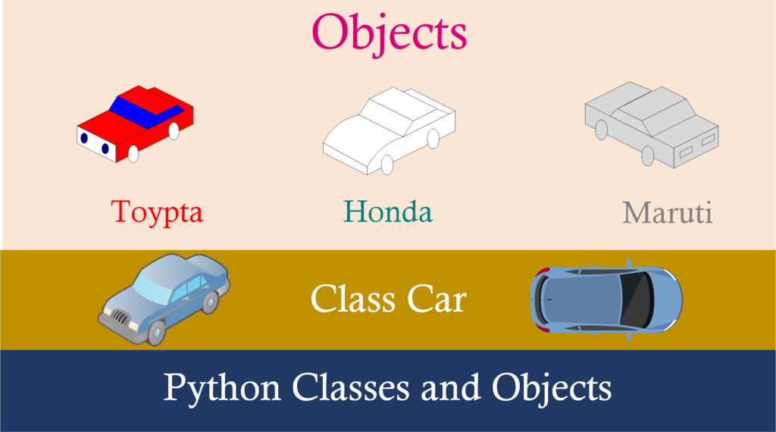
class and object
Python is an object oriented programming language.
Almost everything in Python is an object, with its properties and methods.
A Class is like an object constructor.
Class is like a blueprint for creating objects.

Slide 202
A class is a user-defined blueprint or prototype from which objects are created.
Classes provide a means of bundling data and functionality together. Creating a new
class creates a new type of object, allowing new instances of that type to be made. Each
class instance can have attributes attached to it for maintaining its state. Class
instances can also have methods (defined by their class) for modifying their state.
To understand more about class ,let us consider an example,
let's say we want to track number of cars, that may have different attributes like brand,
color, year etc . If a list is used, the first element could be the car’s brand while the
second element could represent its color.
Let’s suppose there are 100 different cars, then how would we know which element is
supposed to be which?
What if we wanted to add other properties to these cars?
This lacks organization and it’s the exact need for classes.

Slide 203
Class creates a user-defined data structure, which holds its own data members and member functions, which can be accessed and used by creating an instance of that class.
Classes are created by keyword class.
Attributes are the variables that belong to a class.
Attributes are always public and can be accessed using the dot (.) operator. Eg.: Myclass.Myattribute
Create a Class
class MyClass:
x = 5
to create class we use keyword class,above example we create a variable inside a class called Myclass, which is an object.
let's talk about object.

Slide 204
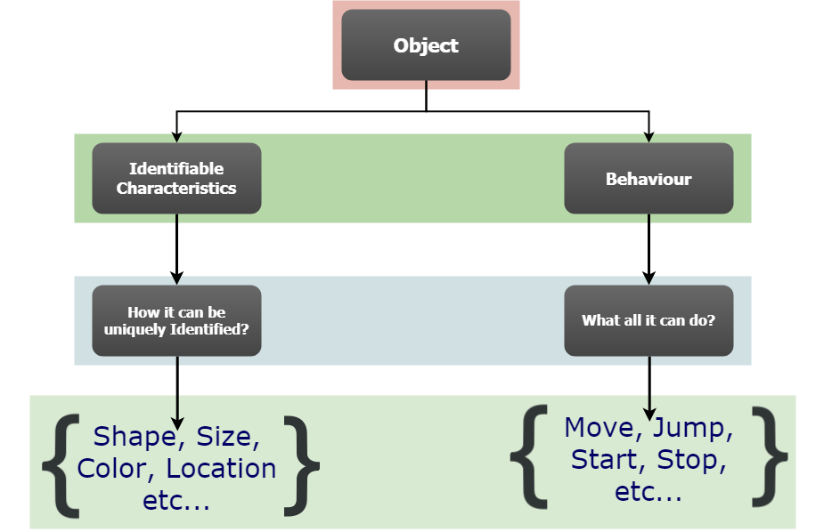
Class Objects
An Object is an instance of a Class. A class is like a blueprint while an instance is a copy of the class with actual values. It’s not an idea anymore, it’s an actual car , like a car of brand TATA who’s red in color. we can have many cars to create many different instances, but without the class as a guide, you would be lost, not knowing what information is required.
An object consists of :
State: It is represented by the attributes of
an object. It also reflects the properties of an object.
Behavior: It is represented by the methods of an
object.It also reflects the response of an object
to other objects.
Identity: It gives a unique name to an object and
enables one object to interact with other objects.

Slide 205
State/ Attributes
Brand
Color
Behaviours
speed
mileage
Identity
name of the car
Declaring Objects
When an object of a class is created, the class is said to be instantiated. All the instances share the attributes and the behavior of the class. But the values of those attributes, i.e. the state are unique for each object. A single class may have any number of instances.
class cars Attributes
car1 brand car3
car2 color car4
Behaviours
speed
mileage

Slide 206
eg:
class Cars: # A simple class attribute
attr1 = "BMW"
attr2 = "series1"\
def fun(self): # A sample method
print("I'm from", self.attr1)
print("my model is ", self.attr2)
John= Cars() # Driver code Object instantiation
print(John.attr1) # Accessing class attributes and method through objects
John.fun()

Slide 207
output:
BMW
I'm from BMW
my model is series1
The self
Class methods must have an extra first parameter in the method definition. We do not
give a value for this parameter when we call the method, Python provides it.
If we have a method that takes no arguments, then we still have to have one argument.
This is similar to this pointer in C++ and this reference in Java.
When we call a method of this object as myobject.method(arg1, arg2), this is
automatically converted by Python into MyClass.method(myobject, arg1, arg2) – this is all
the special self is about.

Slide 208
__init__ method
The __init__ method is similar to constructors in C++ and Java. Constructors are used to initializing the object’s state. Like methods, a constructor also contains a collection of statements(i.e. instructions) that are executed at the time of Object creation. It runs as soon as an object of a class is instantiated. The method is useful to do any initialization you want to do with your object.
eg:
class Person:
# init method or constructor
def __init__(self, name):
self.name = name
# Sample Method
def say_hi(self):
print('Hello, my name is', self.name)
p = Person('vignesh')
p.say_hi()

Slide 209
output:
Hello, my name is vignesh
eg2:
class Cars:
# Class Variable
fourwheeler = 'cars'
# The init method or constructor
def __init__(self, brand, color):
# Instance Variable
self.brand = brand
self.color = color
def fun(self):
print("hello", self.brand)
print("and color is", self.color)
# Objects of Cars class
TATA = Cars("NEXON", "brown")
mustang = Cars("ford", "orange")
TATA.fun())

Slide 210
Modify Object Properties
we can modify the values of the instance variable.
TATA.color = “red”
Delete Object Properties
we can delete the properties of an object by,
del TATA.color
we can delete the whole objects, by
del TATA

Slide 211
Constructors and Destructors
Constructors are generally used for instantiating an object. The task of constructors is to initialize(assign values) to the data members of the class when an object of the class is created. In Python the __init__() method is called the constructor and is always called when an object is created.
Types of constructors :
Default constructor: The default constructor is a simple constructor which doesn’t accept any arguments. Its definition has only one argument which is a reference to the instance being constructed.
Parameterized constructor: constructor with parameters is known as parameterized constructor. The parameterized constructor takes its first argument as a reference to the instance being constructed known as self and the rest of the arguments are provided by the programmer.

Slide 212
eg of default constructor
class Myclass:
# default constructor
def __init__(self):
self.hello= "hello"
# a method for printing data members
def print_hello(self):
print(self.hello)
# creating object of the class
obj = Myclass()
# calling the instance method using the object obj
obj.print_hello()
output:
hello

Slide 213
eg of parameterized constructor:
class Myclass:
first = 0
second = 0
answer = 0
# parameterized constructor
def __init__(self, f, s):
self.first = f
self.second = s
def display(self):
print("First number = " + str(self.first))
print("Second number = " + str(self.second))
print("Addition of two numbers = " + str(self.answer))
def calculate(self):
self.answer = self.first + self.second

Slide 214
# creating object of the class , this will invoke parameterized constructor
obj = Myclass(2000, 2000)
# perform Addition
obj.calculate()
# display result
obj.display()
output:
First number = 2000
Second number = 2000
Addition of two numbers = 4000

Slide 215
Destructors
Destructors
Destructors are called when an object gets destroyed. In Python, destructors are not needed
as much needed in C++ because Python has a garbage collector that handles memory
management automatically.
The __del__() method is a known as a destructor method in Python. It is called when all
references to the object have been deleted i.e when an object is garbage collected.
Syntax:
def __del__(self):
# body of destructor

Slide 216
Example 1 : Here is the simple example of destructor. By using del keyword we deleted the all references of object ‘obj’, therefore destructor invoked automatically.
class Employee:
def __init__(self): # Initializing
print('Employee created.')
def __del__(self): # Deleting (Calling destructor)
print('Destructor called, Employee deleted.')
obj = Employee()
del obj
output:
Employee created.
Destructor called, Employee deleted.

Slide 217
The destructor was called after the program ended or when all the references to object are deleted i.e when the reference count becomes zero, not when object went out of scope.
Example 2 :This example gives the explanation of above mentioned note. Here, notice that the destructor is called after the ‘Program End…’ printed.
class Employee:
def __init__(self): # Initializing
print('Employee created')
def __del__(self): # Calling destructor
print("Destructor called")
def Create_obj():
print('Making Object...')
obj = Employee()
print('function end...')
return obj

Slide 218
print('Calling Create_obj() function...')
obj = Create_obj()
print('Program End...')
Output:
Calling Create_obj() function...
Making Object...
Employee created
function end...
Program End...
Destructor called

Slide 219
Introduction to oops

Slide 220
Procedural vs Modular programming
Procedural Programming:
Procedural Programming can be defined as a programming model which is derived from structured programming, based upon the concept of calling procedure. Procedures, also known as routines, subroutines or functions, simply consist of a series of computational steps to be carried out. During a program’s execution, any given procedure might be called at any point, including by other procedures or itself.
Languages used in Procedural Programming:
FORTRAN, ALGOL, COBOL,
BASIC, Pascal and C.

Slide 221
Object Oriented Programming:
Object oriented programming can be defined as a programming model which is based upon the concept of objects. Objects contain data in the form of attributes and code in the form of methods. In object oriented programming, computer programs are designed using the concept of objects that interact with real world. Object oriented programming languages are various but the most popular ones are class-based, meaning that objects are instances of classes, which also determine their types.
Languages used in Object Oriented Programming:
Java, C++, C#, Python,
PHP, JavaScript, Ruby, Perl,
Objective-C, Dart, Swift, Scala.

Slide 222
Python OOPs Concepts
An object-oriented paradigm is to design the program using classes and objects. The object is related to real-word entities such as book, house, pencil, etc. The oops concept focuses on writing the reusable code. It is a widespread technique to solve the problem by creating objects.
Major principles of object-oriented programming system are given below.
Class
Object
Method
Inheritance
Polymorphism
Data Abstraction
Encapsulation
we saw how object and class will work , now we discuss more about oops.

Slide 223
Data abstraction
Abstraction is used to hide the internal functionality of the function from the users. The users only interact with the basic implementation of the function, but inner working is hidden. User is familiar with that "what function does" but they don't know "how it does."
A class that consists of one or more abstract method is called the abstract class. Abstract methods do not contain their implementation. Abstract class can be inherited by the subclass and abstract method gets its definition in the subclass. Abstraction classes are meant to be the blueprint of the other class. An abstract class can be useful when we are designing large functions. An abstract class is also helpful to provide the standard interface for different implementations of components. Python provides the abc module to use the abstraction in the Python program. Let's see the following syntax.
Syntax
from abc import ABC
class ClassName(ABC):
We import the ABC class from the abc module.

Slide 224
Data Hiding
In Python, we use double underscore (Or __) before the attributes name and those attributes will not be directly visible outside.
class MyClass:
# Hidden member of MyClass
__hiddenVariable = 0
# A member method that changes
# __hiddenVariable
def add(self, increment):
self.__hiddenVariable += increment
print (self.__hiddenVariable)
# Driver code
myObject = MyClass()
myObject.add(2)
myObject.add(5)
# This line causes error
print (myObject.__hiddenVariable)

Slide 225
Output :
2
7
Traceback (most recent call last):
File "filename.py", line 13, in
print (myObject.__hiddenVariable)
AttributeError: MyClass instance has
no attribute '__hiddenVariable'
In the above program, we tried to access a hidden variable outside the class using an object and it threw an exception.

Slide 226
We can access the value of a hidden attribute by a tricky syntax:
class MyClass:
# Hidden member of MyClass
__hiddenVariable = 10
# Driver code
myObject = MyClass()
print(myObject._MyClass__hiddenVariable)
Output :
10

Slide 227
Private methods are accessible outside their class, just not easily accessible. Nothing in Python is truly private; internally, the names of private methods and attributes are mangled and unmangled on the fly to make them seem inaccessible by their given names.
Encapsulation
Encapsulation is the packing of data and functions that work on that data within a single object. By doing so, you can hide the internal state of the object from the outside. This is known as information hiding.
A class is an example of encapsulation. A class bundles data and methods into a single unit. And a class provides the access to its attributes via methods.
The idea of information hiding is that if you have an attribute that isn’t visible to outside, you can control the access to its value to make sure your object is always has a valid state.

Slide 228
eg: The following defines the Counter class:
class Counter:
def __init__(self):
self.current = 0
def increment(self):
self.current += 1
def value(self):
return self.current
def reset(self):
self.current = 0
The Counter class has one attribute called current which defaults to zero. And it has three methods:
increment() increases the value of the current attribute by one.
value() returns the current value of the current attribute.
reset() sets the value of the current attribute to zero.

Slide 229
The following creates a new instance of the Counter class and calls the increment() method three times before showing the current value of the counter to the screen.
counter = Counter()
counter.increment()
counter.increment()
counter.increment()
print(counter.value())
output:
3

Slide 230
Private attributes
Private attributes can be only accessible from the methods of the class. In other words, they cannot be accessible from outside of the class.
To make an attribute private, you prefix it with a double underscore (__). The following redefines the Counter class with the current as a private attribute:
class Counter:
def __init__(self):
self.__current = 0
def increment(self):
self.__current += 1
def value(self):
return self.__current
def reset(self):
self.__current = 0

Slide 231
The following creates a new instance of the Counter class and access the __current attribute:
counter = Counter()
print(counter.__current)
output :
AttributeError: 'Counter' object has no attribute '__current'
the Counter class now can protect its internal state from the outside.
Then how can we access the private value , we can with small trick.

Slide 232
When you prefix an attribute with a double underscore (__), Python internally masks that attribute by a new name:
_class___attribute
For example, you still can access the __current attribute outside of the Counter class as follows:
counter = Counter()
counter.increment()
print(counter._Counter__current)
Output:
1
So Python just makes it difficult to access private attributes. It doesn’t prevent you
from accessing them

Slide 233
Modularity
Modularity refers to the act of partitioning the code into modules building them
first followed by linking and finally combining them to form a complete project.
Modularity ensures re-usability and thrives to minimize the duplication.
A module in Python is nothing but a file containing Python definitions followed by
methods & statements. The module name is generated out of the file name by
removing the suffix “.py”. For example, if the file name is prime.py, the module
name is prime. Let's create a module. We save the following code in the file
prime.py −

Slide 234
def isPrimenot(n) :
# Corner cases
if (n <= 1) :
print(“False”)
if (n <= 3) :
print(“True”)
if (n % 2 == 0 or n % 3 == 0) :
print(“False”)
i = 5
while(i * i <= n) :
if (n % i == 0 or n % (i + 2) == 0) :
print(“False”)
i = i + 6
print(“True”)

Slide 235
When we run the command line we observe:
>>> import prime
>>> prime.isPrimenot(3)
True
>>> prime.isPrimenot(8)
False
We can also assign a local name to the module as well and implement the function as described below.
>>> import prime
>>> p=prime.isPrimenot
>>> p(8)
False
In this way, the code can be used at multiple places without the need of writing it again and again in the code. Hence Modularity supports code reusability and minimal dependencies.
Tip: Each module can be imported exactly once in a single interpreter session. If we change the module’s content or want to reload it, we must restart the interpreter again.

Slide 236
Inheritance
Inheritance is the capability of one class to derive or inherit the properties from another class. The benefits of inheritance are:
It represents real-world relationships well.
It provides reusability of a code. We don’t have to write the same code again and again. Also, it allows us to add more features to a class without modifying it.
It is transitive in nature, which means that if class B inherits from another class A, then all the subclasses of B would automatically inherit from class A.

Slide 237
class Person(object):
def __init__(self, name): # Constructor
self.name = name
def getName(self): # To get name
return self.name
def isEmployee(self): # To check if this person is an employee
return False
class Employee(Person): # Inherited or Subclass (Note Person in bracket)
def isEmployee(self): # Here we return true
return True
# Driver code
emp = Person("sathya") # An Object of Person
print(emp.getName(), emp.isEmployee())
emp = Employee("vignesh") # An Object of Employee
print(emp.getName(), emp.isEmployee())

Slide 238
Output:
sathya False
vignesh True
A child class needs to identify which class is its parent class. This can be done by mentioning the parent class name in the definition of the child class.
Eg: class subclass_name (superclass_name):
Here is an example of one employee , with a base class of person and employee class is inheritance of person.
that is:

Slide 239
class Person( object ):
def __init__(self, name, idnumber): # __init__ is known as the constructor
self.name = name
self.idnumber = idnumber
def display(self):
print(self.name)
print(self.idnumber)
class Employee( Person ): # child class
def __init__(self, name, idnumber, salary, post):
self.salary = salary
self.post = post

Slide 240
Person.__init__(self, name, idnumber) # invoking the __init__ of theparent class
a = Employee('vignesh', 0098237, 2000, "Intern") # creation of an object variable or an instance
  a.display() # calling a function of the class Person using its instance
Output:
vignesh
0098237

Slide 241
‘a’ is the instance created for the class Person. It invokes the __init__() of the referred class. You can see ‘object’ written in the declaration of the class Person. In Python, every class inherits from a built-in basic class called ‘object’. The constructor i.e. the ‘__init__’ function of a class is invoked when we create an object variable or an instance of the class.
The variables defined within __init__() are called as the instance variables or objects. Hence, ‘name’ and ‘idnumber’ are the objects of the class Person. Similarly, ‘salary’ and ‘post’ are the objects of the class Employee. Since the class Employee inherits from class Person, ‘name’ and ‘idnumber’ are also the objects of class Employee.
If you forget to invoke the __init__() of the parent class then its instance variables would not be available to the child class.

Slide 242
Different forms of Inheritance:
Single inheritance: When a child class inherits from only one parent class, it is called single inheritance. We saw an example above.
Multiple inheritance: When a child class inherits from multiple parent classes, it is called multiple inheritance. Unlike Java and like C++, Python supports multiple inheritance. We specify all parent classes as a comma-separated list in the bracket.

Slide 243
class Base1(object):
def __init__(self):
self.str1 = "hello"
print("Base1")
class Base2(object):
def __init__(self):
self.str2 = "hy"
print("Base2")
class Derived(Base1, Base2):
def __init__(self):
Base1.__init__(self) # Calling constructors of Base1 and Base2 classes
Base2.__init__(self)
print("Derived")
def printStrs(self):
print(self.str1, self.str2)
ob = Derived()
ob.printStrs()

Slide 244
Output:
Base1
Base2
Derived
hellohy
3. Multilevel inheritance: When we have a child and grandchild relationship.
class Base(object):
def __init__(self, name): # Constructor
self.name = name
def getName(self): # To get name
return self.name

Slide 245
class Child(Base): # Inherited or Sub class (Note Person in bracket)
def __init__(self, name, age): # Constructor
Base.__init__(self, name)
self.age = age
def getAge(self): # To get name
return self.age
class GrandChild(Child): # Inherited or Sub class (Note Person in bracket)
def __init__(self, name, age, address): # Constructor
Child.__init__(self, name, age)
self.address = address
def getAddress(self): # To get address
return self.address
g = GrandChild("vignesh", 23, "tvpm") # Driver code
print(g.getName(), g.getAge(), g.getAddress())

Slide 246
Output:
vignesh 23 tvpm
4. Hierarchical inheritance More than one derived classes are created from a single base.
5. Hybrid inheritance: This form combines more than one form of inheritance. Basically, it is a blend of more than one type of inheritance.
Private members of parent class
We don’t always want the instance variables of the parent class to be inherited by the child class i.e. we can make some of the instance variables of the parent class private, which won’t be available to the child class.
We can make an instance variable by adding double underscores before its name. For example,

Slide 247
class C(object):
def __init__(self):
self.c = 21
self.__d = 42 # d is private instance variable
class D(C):
def __init__(self):
self.e = 84
C.__init__(self)
object1 = D()
print(object1.d) # produces an error as d is private instance variable
Output :
File "/home/993bb61c3e76cda5bb67bd9ea05956a1.py", line 16, in
print (object1.d)
AttributeError: type object 'D' has no attribute 'd'
Since ‘d’ is made private by those underscores, it is not available to the child class ‘D’ and hence the error.

Slide 248
Polymorphism
The word polymorphism means having many forms. In programming, polymorphism means the same function name (but different signatures) being used for different types.
eg:
# Python program to demonstrate in-built poly-morphic functions
print(len("python")) # len() being used for a string
print(len([10, 20, 30])) # len() being used for a list
Output:
6
3

Slide 249
# A simple Python function to demonstrate Polymorphism
def add(x, y, z = 0):
return x + y+z
print(add(2, 3)) # Driver code
print(add(2, 3, 4))
output:
5
9

Slide 250
Polymorphism with class methods:
The below code shows how Python can use two different class types, in the same way. We create a for loop that iterates through a tuple of objects. Then call the methods without being concerned about which class type each object is. We assume that these methods actually exist in each class.
class India():
def capital(self):
print("New Delhi is the capital of India.")
def language(self):
print("Hindi is the most widely spoken language of India.")
def type(self):
print("India is a developing country.")

Slide 251
class USA():
def capital(self):
print("Washington, D.C. is the capital of USA.")
def language(self):
print("English is the primary language of USA.")
def type(self):
print("USA is a developed country.")
obj_ind = India()
obj_usa = USA()
for country in (obj_ind, obj_usa):
country.capital()
country.language()
country.type()

Slide 252
Output:
New Delhi is the capital of India.
Hindi is the most widely spoken language of India.
India is a developing country.
Washington, D.C. is the capital of USA.
English is the primary language of USA.
USA is a developed country.
Polymorphism with Inheritance:
In Python, Polymorphism lets us define methods in the child class that have the same name as
the methods in the parent class. In inheritance, the child class inherits the methods from the
parent class. However, it is possible to modify a method in a child class that it has inherited from
the parent class. This is particularly useful in cases where the method inherited from the parent
class doesn’t quite fit the child class. In such cases, we re-implement the method in the child
class. This process of re-implementing a method in the child class is known as Method Overriding.

Slide 253
class Bird:
def intro(self):
print("There are many types of birds.")
def flight(self):
print("Most of the birds can fly but some cannot.")
class sparrow(Bird):
def flight(self):
print("Sparrows can fly.")
class ostrich(Bird):
def flight(self):
print("Ostriches cannot fly.")

Slide 254
obj_bird = Bird()
obj_spr = sparrow()
obj_ost = ostrich()
obj_bird.intro()
obj_bird.flight()
obj_spr.intro()
obj_spr.flight()
obj_ost.intro()
obj_ost.flight()

Slide 255
Output:
There are many types of birds.
Most of the birds can fly but some cannot.
There are many types of birds.
Sparrows can fly.
There are many types of birds.
Ostriches cannot fly.
Polymorphism with a Function and objects:
It is also possible to create a function that can take any object, allowing for polymorphism. In this
example, let’s create a function called “func()” which will take an object which we will name
“obj”. Though we are using the name ‘obj’, any instantiated object will be able to be called into
this function. Next, let’s give the function something to do that uses the ‘obj’ object we passed to
it. In this case, let’s call the three methods, viz., capital(), language() and type(), each of which is
defined in the two classes ‘India’ and ‘USA’. Next, let’s create instantiations of both the ‘India’
and ‘USA’ classes if we don’t have them already. With those, we can call their action using the
same func() function:

Slide 256
def func(obj):
obj.capital()
obj.language()
obj.type()
obj_ind = India()
obj_usa = USA()
func(obj_ind)
func(obj_usa)
if we change the last part of program in previous lesson we get the same output but we call with the functions.

Slide 257
Iterator

Slide 258
An iterator is an object that contains a countable number of values.
An iterator is an object that can be iterated upon, meaning that you can traverse through all the values.
Technically, in Python, an iterator is an object which implements the iterator protocol, which consist of the methods __iter__() and __next__().

Slide 259
Iterator vs Iterable
Lists, tuples, dictionaries, and sets are all iterable objects. They are iterable containers which you can get an iterator from.
All these objects have a iter() method which is used to get an iterator
Eg:
mytuple = ("apple", "banana", "cherry")
myit = iter(mytuple)
print(next(myit))
print(next(myit))
print(next(myit))

Slide 260
Even strings are iterable objects, and can return an iterator:
Eg:
mystr = "banana“
myit = iter(mystr)
print(next(myit))
print(next(myit))
print(next(myit))
print(next(myit))
print(next(myit))
print(next(myit)

Slide 261
Looping Through an Iterator
We can also use a for loop to iterate through an iterable object:
Eg:
mytuple = ("apple", "banana", "cherry")
for x in mytuple:
print(x)

Slide 262
Create an Iterator
To create an object/class as an iterator you have to implement the methods __iter__() and __next__() to your object.
As you have learned in the OOPS chapter, all classes have a function called __init__(), which allows you to do some initializing when the object is being created.
The __iter__() method acts similar, you can do operations (initializing etc.), but must always return the iterator object itself.
The __next__() method also allows you to do operations, and must return the next item in the sequence.

Slide 263
class MyNumbers:
def __iter__(self):
self.a = 1
return self
def __next__(self):
x = self.a
self.a += 1
return x
myclass = MyNumbers()
myiter = iter(myclass)
print(next(myiter))
print(next(myiter))
print(next(myiter))
print(next(myiter))
print(next(myiter))

Slide 264
Generators

Slide 265
Continue..
Typically, Python executes a regular function from top to bottom based on the run-to-completion model.
To pause a function midway and resume from where the function was paused, you use the yield statement.
When a function contains at least one yield statement, it’s a generator function.
By definition, a generator is a function that contains at least one yield statement.
When you call a generator function, it returns a new generator object. However, it doesn’t start the function.
Generator objects (or generators) implement the iterator protocol. In fact, generators are lazy iterators. Therefore, to execute a generator function, you call the next() built-in function on it.

Slide 266
Continue…
Eg:
def greeting():
print('Hi!')
yield 1
print('How are you?')
yield 2
print('Are you there?')
yield 3

Slide 267
Continue…
Since the greeting() function contains the yield statements, it’s a generator function.
The yield statement is like a return statement in a function. However, there’s a big difference.
When Python encounters the yield statement, it returns the value specified in the yield. In addition, it pauses the execution of the function.
If you “call” the same function again, Python will resume from where the previous yield statement was encountered.
When you call a generator function, it returns a generator object. For example:

Slide 268
Continue…
messenger = greeting()
The messenger is a generator object, which is also an iterator.
To actually execute the body of the greeting() function, you need to use the next() built-in function:
result = next(messenger) print(result)
Code language: Python (python)When you the greeting() function executes, it shows the first message and returns 1:
Hi! 1

Slide 269
Continue….
result = next(messenger)
print(result)
Output:
How are you?
2
result = next(messenger)
print(result)
Output:
Are you there?
3

Slide 270
Continue..
Python generators are functions that contain at least one yield statement.
A generator function returns a generator object.
A generator object is an iterator. Therefore, it becomes exhausted once there’s no remaining item to return.

Slide 271
Multithreading

Slide 272
Multithreading
Let us first understand the concept of thread in computer architecture.
Thread
In computing, a process is an instance of a computer program that is being executed. Any process has 3 basic components:
An executable program.
The associated data needed by the program (variables, work space, buffers, etc.)
The execution context of the program (State of process)
A thread is an entity within a process that can be scheduled for execution. Also, it is the smallest unit of processing that can be performed in an OS (Operating System).

Slide 273
In simple words, a thread is a sequence of such instructions within a program that can be executed independently of other code. For simplicity, you can assume that a thread is simply a subset of a process!
A thread contains all this information in a Thread Control Block (TCB):
Thread Identifier: Unique id (TID) is assigned to every new thread
Stack pointer: Points to thread’s stack in the process. Stack contains the local variables under thread’s scope.
Program counter: a register which stores the address of the instruction currently being executed by thread.
Thread state: can be running, ready, waiting, start or done.
Thread’s register set: registers assigned to thread for computations.
Parent process Pointer: A pointer to the Process control block (PCB) of the process that the thread lives on.

Slide 274
Multithreading
Multiple threads can exist within one process where:
Each thread contains its own register set and local variables (stored in stack).
All thread of a process share global variables (stored in heap) and the program code.
Consider the diagram below to understand how multiple threads exist in memory:
Multithreading is defined as the ability of a processor to execute multiple threads concurrently.
In a simple, single-core CPU, it is achieved using frequent switching between threads. This is termed as context switching. In context switching, the state of a thread is saved and state of another thread is loaded whenever any interrupt (due to I/O or manually set) takes place. Context switching takes place so frequently that all the threads appear to be running parallely (this is termed as multitasking).

Slide 275
Multithreading in Python
In Python, the threading module provides a very simple and intuitive API for spawning multiple threads in a program.
Let us consider a simple example using threading module:
# Python program to illustrate the concept of threading importing the threading module
import threading
def print_cube(num):
"""
function to print cube of given num
"""
print("Cube: {}".format(num * num * num))
def print_square(num):
"""
function to print square of given num
"""
print("Square: {}".format(num * num))

Slide 276
if __name__ == "__main__":
# creating thread
t1 = threading.Thread(target=print_square, args=(10,))
t2 = threading.Thread(target=print_cube, args=(10,))
# starting thread 1
t1.start()
# starting thread 2
t2.start()
# wait until thread 1 is completely executed
t1.join()
# wait until thread 2 is completely executed
t2.join()
# both threads completely executed
print("Done!")

Slide 277
Output:
Square: 100
Cube: 1000
Done!
Let us try to understand the above code:
To import the threading module, we do:
import threading
To create a new thread, we create an object of Thread class. It takes following arguments:
  target: the function to be executed by thread
  args: the arguments to be passed to the target function
In above example, we created 2 threads with different target functions:
t1 = threading.Thread(target=print_square, args=(10,))
t2 = threading.Thread(target=print_cube, args=(10,))

Slide 278
To start a thread, we use start method of Thread class.
t1.start()
t2.start() Once the threads start, the current program (you can think of it like a main thread) also keeps on executing. In order to stop execution of current program until a thread is complete, we use join method t1.join() t2.join()
As a result, the current program will first wait for the completion of t1 and then t2. Once, they are finished, the remaining statements of current program are executed.

Slide 279
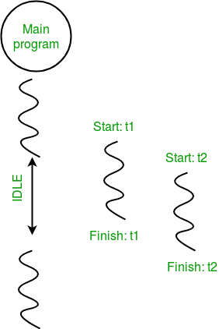
Consider the diagram below for a better understanding of how above program works:

Slide 280
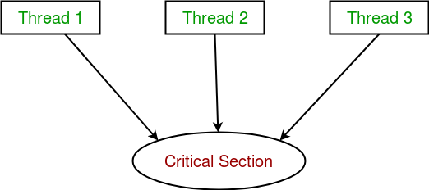
Synchronization between threads
Thread synchronization is defined as a mechanism which ensures that two or more concurrent threads do not simultaneously execute some particular program segment known as critical section.
Critical section refers to the parts of the program where the shared resource is accessed.
For example, in the diagram below, 3 threads try to access shared resource or critical section at the same time.

Slide 281
Concurrent accesses to shared resource can lead to race condition.
A race condition occurs when two or more threads can access shared data and they try to change it at the same time. As a result, the values of variables may be unpredictable and vary depending on the timings of context switches of the processes.
Consider the program below to understand the concept of race condition:
import threading
# global variable x
x = 0
def increment():
"""
function to increment global variable x
"""
global x
x += 1

Slide 282
def thread_task():
"""
task for thread
calls increment function 100000 times.
"""
for _ in range(100000):
increment()
def main_task():
global x
# setting global variable x as 0
x = 0
# creating threads
t1 = threading.Thread(target=thread_task)
t2 = threading.Thread(target=thread_task)
# start threads
t1.start()
t2.start()

Slide 283
# wait until threads finish their job
t1.join()
t2.join()
if __name__ == "__main__":
for i in range(10):
main_task()
print("Iteration {0}: x = {1}".format(i,x))
And the output will be:

Slide 284
Output:
Iteration 0: x = 175005
Iteration 1: x = 200000
Iteration 2: x = 200000
Iteration 3: x = 169432
Iteration 4: x = 153316
Iteration 5: x = 200000
Iteration 6: x = 167322
Iteration 7: x = 200000
Iteration 8: x = 169917
Iteration 9: x = 153589
In above program:
Two threads t1 and t2 are created in main_task function and global variable x is set to 0.
Each thread has a target function thread_task in which increment function is called 100000 times.
increment function will increment the global variable x by 1 in each call.

Slide 285
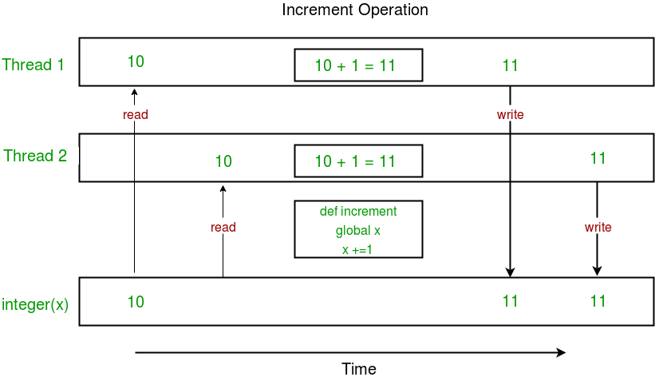
The expected final value of x is 200000 but what we get in 10 iterations of main_task function is some different values.
This happens due to concurrent access of threads to the shared variable x. This unpredictability in value of x is nothing but race condition.
Given below is a diagram which shows how can race condition occur in above program:

Slide 286
Notice that expected value of x in above diagram is 12 but due to race condition, it turns out to be 11!
Hence, we need a tool for proper synchronization between multiple threads.
Using Locks
threading module provides a Lock class to deal with the race conditions. Lock is implemented using a Semaphore object provided by the Operating System.
A semaphore is a synchronization object that controls access by multiple processes/threads to a common resource in a parallel programming environment. It is simply a value in a designated place in operating system (or kernel) storage that each process/thread can check and then change. Depending on the value that is found, the process/thread can use the resource or will find that it is already in use and must wait for some period before trying again. Semaphores can be binary (0 or 1) or can have additional values. Typically, a process/thread using semaphores checks the value and then, if it using the resource, changes the value to reflect this so that subsequent semaphore users will know to wait.

Slide 287
Lock class provides following methods:
acquire([blocking]) : To acquire a lock. A lock can be blocking or non-blocking.
  When invoked with the blocking argument set to True (the default), thread execution is blocked until the lock is unlocked, then lock is set to locked and return True.
  When invoked with the blocking argument set to False, thread execution is not blocked. If lock is unlocked, then set it to locked and return True else return False immediately.
release() : To release a lock.
  When the lock is locked, reset it to unlocked, and return. If any other threads are blocked waiting for the lock to become unlocked, allow exactly one of them to proceed.
  If lock is already unlocked, a ThreadError is raised.

Slide 288
Consider the example given below:
import threading
# global variable x
x = 0
def increment():
"""
function to increment global variable x
"""
global x
x += 1
def thread_task(lock):
"""
task for thread
calls increment function 100000 times.
"""
for _ in range(100000):
lock.acquire()
increment()
lock.release()

Slide 289
def main_task():
global x
# setting global variable x as 0
x = 0
# creating a lock
lock = threading.Lock()
# creating threads
t1 = threading.Thread(target=thread_task, args=(lock,))
t2 = threading.Thread(target=thread_task, args=(lock,))
# start threads
t1.start()
t2.start()
# wait until threads finish their job
t1.join()
t2.join()
if __name__ == "__main__":
for i in range(10):
main_task()
print("Iteration {0}: x = {1}".format(i,x))

Slide 290
Output:
Iteration 0: x = 200000
Iteration 1: x = 200000
Iteration 2: x = 200000
Iteration 3: x = 200000
Iteration 4: x = 200000
Iteration 5: x = 200000
Iteration 6: x = 200000
Iteration 7: x = 200000
Iteration 8: x = 200000
Iteration 9: x = 200000
Let us try to understand the above code step by step:
Firstly, a Lock object is created using:
lock = threading.Lock()

Slide 291
Then, lock is passed as target function argument:
t1 = threading.Thread(target=thread_task, args=(lock,))
t2 = threading.Thread(target=thread_task, args=(lock,))
In the critical section of target function, we apply lock using lock.acquire() method. As soon as a lock is acquired, no other thread can access the critical section (here, increment function) until the lock is released using lock.release() method.
lock.acquire()
increment()
lock.release()

Slide 292
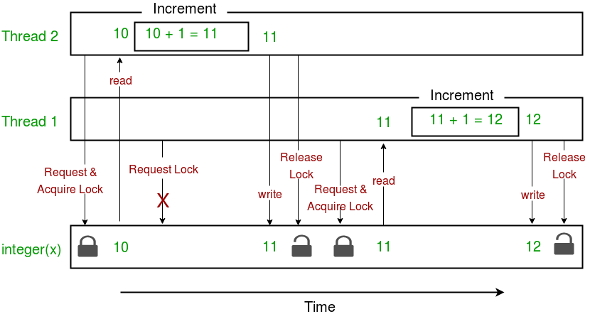
As you can see in the results, the final value of x comes out to be 200000 every time (which is the expected final result).
Here is a diagram given below which depicts the implementation of locks in above program:

Slide 293
This brings us to the end of this tutorial series on Multithreading in Python.
Finally, here are a few advantages and disadvantages of multithreading:
Advantages:
It doesn’t block the user. This is because threads are independent of each other.
Better use of system resources is possible since threads execute tasks parallely.
Enhanced performance on multi-processor machines.
Multi-threaded servers and interactive GUIs use multithreading exclusively.
Disadvantages:
As number of threads increase, complexity increases.
Synchronization of shared resources (objects, data) is necessary.
It is difficult to debug, result is sometimes unpredictable.
Potential deadlocks which leads to starvation, i.e. some threads may not be served with a bad design
Constructing and synchronizing threads is CPU/memory intensive.

Slide 294
File Handling

Slide 295
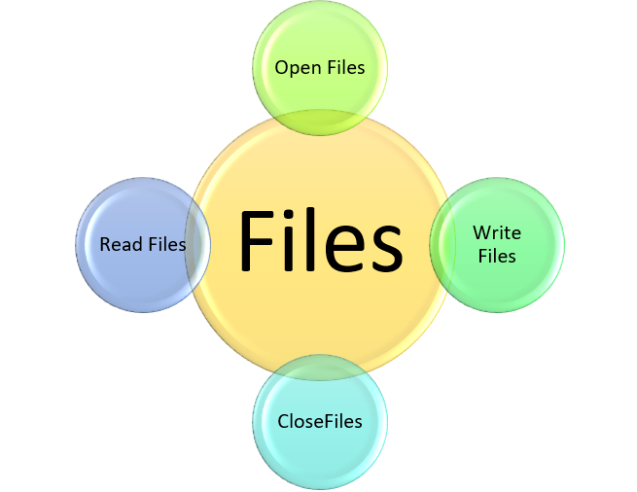
File handling in python
we can handle the files using python ie; we can
do many operations with the files using python.
The concept of file handling has stretched over
various other languages, but the implementation
is either complicated or lengthy, but alike other
concepts of Python, this concept here is also easy
and short. Python treats files differently as text or
binary.Each line of code includes a sequence of
characters and they form text file.
Each line of a file is terminated with a special character, called the EOL or End of
Line characters like comma {,} or newline character. It ends the current line and
tells the interpreter a new one has begun.

Slide 296
Open a file.
We use open () function in Python to open a file in read or write mode. As explained above,
open ( ) will return a file object. To return a file object we use open() function along with two
arguments, that accepts file name and the mode, whether to read or write. So, the syntax
being: open(filename, mode). There are three kinds of mode, that Python provides and how
files can be opened.
“ r “, for reading.
“ w “, for writing.
“ a “, for appending.
“ r+ “, for both reading and writing.
note: The mode argument is not mandatory. If not passed, then Python will assume it to be
“ r ” by default.

Slide 297
file = open('python.txt', 'r') # a file named "python", will be opened with the reading mode.
for line in file: # This will print every line one by one in the file
print (line)
There is more than one way to read a file in Python. If you need to extract a string that contains all characters in the file then we can use file.read().
file = open("file.text", "r")
print (file.read())
Another way to read a file is to call a certain number of characters like in the following code the interpreter will read the first five characters of stored data and return it as a string.

Slide 298
file = open("file.txt", "r")
print (file.read(5))
Creating a file using write() mode
To manipulate the file,follow the code.
file = open('python.txt','w')
file.write("This is the write command")
file.write("It allows us to write in a particular file")
file.close()
The close() command terminates all the resources in use and frees the system of this
particular program.

Slide 299
Append() mode
file = open('hello.txt','a')
file.write("This will add this line")
file.close()
we can use some more methods in this file handle too, ie;
split() method. we know split() method ,we split a line in spaces and make it a list.
rstrip(): This function strips each line of a file off spaces from the right-hand side.
lstrip(): This function strips each line of a file off spaces from the left-hand side.

Slide 300
file1 = open("myfile.txt", "w")
L = ["This is Delhi \n", "This is Paris \n", "This is London"]
file1.writelines(L)
file1.close()
file1 = open("myfile.txt", "a") # Append-adds at last append mode
file1.write("\n") # writing newline character
file1.write("Today")
file1.write("Tomorrow") # without newline character
file1 = open("myfile.txt", "r")
print("Output of Readlines after appending")
print(file1.read())
print()
file1.close()

Slide 301
Output:
Output of Readlines after appending
This is Delhi
This is Paris
This is London
TodayTomorrow
With statement
with statement in Python is used in exception handling to make the code cleaner and much
more readable. It simplifies the management of common resources like file streams. Unlike
the above implementations, there is no need to call file.close() when using with statement.
The with statement itself ensures proper acquisition and release of resources.

Slide 302
L = ["This is Delhi \n", "This is Paris \n", "This is London \n"]
with open("myfile.txt", "w") as file1: # Writing to file
file1.write("Hello \n") # Writing data to a file
file1.writelines(L)
with open("myfile.txt", 'a') as file1: # Appending to file
file1.write("Today")
with open("myfile.txt", "r+") as file1: # Reading from file
print(file1.read()) # Reading form a file
Output:
Hello
This is Delhi
This is Paris
This is London
Today

Slide 303
EXCEPTION HANDLING

Slide 304
Error in Python can be of two types i.e. Syntax errors and Exceptions. Errors are the problems in a program due to which the program will stop the execution. On the other hand, exceptions are raised when some internal events occur which changes the normal flow of the program.
Syntax Error: As the name suggests this error is caused by the wrong syntax in the code. It leads to the termination of the program.
Eg:
amount = 100000
if(amount > 4999)
print("You are eligible to purchase Dsa Self Paced")
output:
syntax error
this will be an syntax error, because we did not put the colunn : symbol last at condition
.

Slide 305
Exceptions: Exceptions are raised when the program is syntactically correct, but the code resulted in an error. This error does not stop the execution of the program, however, it changes the normal flow of the program.
eg:
marks = 10000
a = marks / 0
print(a)
output:
traceback error
In the above example raised the ZeroDivisionError as we are trying to divide a number by 0.

Slide 306
Some of the common built-in exceptions are other than above mention exceptions are:
Exception Description
IndexError When the wrong index of a list is retrieved.
AssertionError It occurs when assert statement fails
AttributeError It occurs when an attribute assignment is failed.
ImportError It occurs when an imported module is not found.
KeyError It occurs when the key of the dictionary is not found.
NameError It occurs when the variable is not defined.
MemoryError It occurs when a program run out of memory.
TypeError It occurs when a function and operation is applied in an incorrect type.

Slide 307
Try and Except Statement – Catching Exceptions
Try and except statements are used to catch and handle exceptions in Python. Statements that can raise exceptions are kept inside the try clause and the statements that handle the exception are written inside except clause.
eg:
a = [1, 2, 3]
try:
print ("Second element = %d" %(a[1]))
print ("Fourth element = %d" %(a[3])) # Throws error since there are only 3 elements in array
except:
print ("An error occurred")
Output
Second element = 2
An error occurred

Slide 308
In the above example we use try and except, when we fell any code will be cause error or if we know a something will happen we can use this function.
we can write our doubt full code in try part and we can make our own error indicating statement like the above example.
Catching Specific Exception
A try statement can have more than one except clause, to specify handlers for different exceptions. Please note that at most one handler will be executed. For example, we can add IndexError in the above code. The general syntax for adding specific exceptions are –
try:
# statement(s)
except IndexError:
# statement(s)
except ValueError:
# statement(s)

Slide 309
Catching specific exception in Python
def fun(a):
if a < 4:
b = a/(a-3) # throws ZeroDivisionError for a = 3
print("Value of b = ", b) # throws NameError if a >= 4
try:
fun(3)
fun(5)
# note that braces () are necessary here for multiple exceptions
except ZeroDivisionError:
print("ZeroDivisionError Occurred and Handled")
except NameError:
print("NameError Occurred and Handled")

Slide 310
Output:
ZeroDivisionError Occurred and Handled
If you comment the line fun(3), the output will be
NameError Occurred and Handled
Try with Else Clause
In python, you can also use the else clause on the try-except block which must be present after all the except clauses. The code enters the else block only if the try clause does not raise an exception. eg:
def AbyB(a , b):
try:
c = ((a+b) / (a-b))
except ZeroDivisionError:
print ("a/b result in 0")
else:
print (c)
# Driver program to test above function
AbyB(2.0, 3.0)
AbyB(3.0, 3.0)

Slide 311
Output:
-5.0
a/b result in 0
Finally Keyword in Python
Python provides a keyword finally, which is always executed after the try and except blocks. The finally block always executes after normal termination of try block or after try block terminates due to some exception.
Syntax:
try:
# Some Code....
except:
# optional block
# Handling of exception (if required)
else:
# execute if no exception
finally:
# Some code .....(always executed)

Slide 312
# Python program to demonstrate finally
# No exception Exception raised in try block
try:
k = 5//0 # raises divide by zero exception.
print(k)
except ZeroDivisionError: # handles zerodivision exception
print("Can't divide by zero")
finally:
# this block is always executed regardless of exception generation.
print('This is always executed')
Output:
Can't divide by zero
This is always executed

Slide 313
Raising Exception
The raise statement allows the programmer to force a specific exception to occur. The sole argument in raise indicates the exception to be raised. This must be either an exception instance or an exception class (a class that derives from Exception).
# Program to depict Raising Exception
try:
raise NameError("Hi there") # Raise Error
except NameError:
print ("An exception")
raise # To determine whether the exception was raised or not

Slide 314
The output of the above code will simply line printed as “An exception” but a Runtime error will also occur in the last due to raise statement in the last line. So, the output on your command line will look like
Traceback (most recent call last):
File "/home/d6ec14ca595b97bff8d8034bbf212a9f.py", line 5, in <module>
raise NameError("Hi there") # Raise Error
NameError: Hi there

Slide 315
User-defined Exceptions in Python
Python throws errors and exceptions when there is a code gone wrong, which may
cause the program to stop abruptly. Python also provides an exception handling
method with the help of try-except. Some of the standard exceptions which are
most frequent include IndexError, ImportError, IOError, ZeroDivisionError, TypeError,
and FileNotFoundError. A user can create his own error using the exception class.
Creating User-defined Exception
Programmers may name their own exceptions by creating a new exception class.
Exceptions need to be derived from the Exception class, either directly or indirectly.
Although not mandatory, most of the exceptions are named as names that end in
“Error” similar to the naming of the standard exceptions in python.

Slide 316
eg: A python program to create user-defined exception
class MyError(Exception):
def __init__(self, value): # Constructor or Initializer
self.value = value
def __str__(self): # __str__ is to print() the value
return(repr(self.value))
try:
raise(MyError(3*2))
except MyError as error: # Value of Exception is stored in error
print('A New Exception occured: ',error.value)
Output:
('A New Exception occured: ', 6)

Slide 317
Regular expressions
A RegEx, or Regular Expression, is a sequence of characters that forms a search pattern.
RegEx can be used to check if a string contains the specified search pattern.
RegEx Module
Python has a built-in package called re, which can be used to work with Regular Expressions.
Import the re module:
import re

Slide 318
RegEx in Python
When you have imported the re module, you can start using regular expressions:
Eg:
Search the string to see if it starts with "The" and ends with "Spain":
import re
txt = "The rain in Spain"
x = re.search("^The.*Spain$", txt)
if x:
print("YES! We have a match!")
else:
print("No match")

Slide 319
RegEx Functions
The re module offers a set of functions that allows us to search a string for a match:
Function Description
Findall Returns a list containing all matches
Search Returns a Match object if there is a match anywhere in the string
Split Returns a list where the string has been split at each match
Sub Replaces one or many matches with a string

Slide 320
Metacharacters
Metacharacters are characters with a special meaning:
Character Description Example
[] A set of characters "[a-m]"
\ Signals a special sequence "\d"
(can also be used to escape special characters)
^ Starts with "^hello"
* Zero or more occurrences "aix*"
+ One or more occurrences "aix+"
{} Exactly the specified number of occurrences "al{2}"

Slide 321
Special Sequences
A special sequence is a \ followed by one of the characters in the list below, and has a special meaning:
Character Description Example
\A Returns a match if the specified characters "\AThe"
are at the beginning of the string.
\b Returns a match where the specified characters are r"\bain"
at the beginning or at the end of a word r"ain\b" (the "r" in the beginning is making sure that the
string is being treated as a "raw string")
So many special sequences are there.

Slide 322
Sets
A set is a set of characters inside a pair of square brackets [] with a special meaning:
Set Description
[arn] Returns a match where one of the specified characters (a, r, or n) are present
[a-n] Returns a match for any lower case character, alphabetically between a and n
[^arn] Returns a match for any character EXCEPT a, r, and n
[0123] Returns a match where any of the specified digits (0, 1, 2, or 3) are present
[0-9] Returns a match for any digit between 0 and 9
[0-5][0-9] Returns a match for any two-digit numbers from 00 and 59

Slide 323
[a-zA-Z] Returns a match for any character alphabetically between a and z, lower case OR upper
case
[+] In sets, +, *, ., |, (), $,{} has no special meaning, so [+] means: return a match for any +
character in the string
The findall() Function
The findall() function returns a list containing all matches.
Eg:
Print a list of all matches:
import re
txt = "The rain in Spain"
x = re.findall("ai", txt)
print(x)

Slide 324
The list contains the matches in the order they are found.
If no matches are found, an empty list is returned:
eg:
Return an empty list if no match was found:
import re
txt = "The rain in Spain"
#Check if "Portugal" is in the string:
x = re.findall("Portugal", txt)
print(x)
if (x):
print("Yes, there is at least one match!")
else:
print("No match")

Slide 325
The search() Function
The search() function searches the string for a match, and returns a Match object if there is a match.
If there is more than one match, only the first occurrence of the match will be returned:
Eg:
Search for the first white-space character in the string:
import re
txt = "The rain in Spain"
x = re.search("\s", txt)
print("The first white-space character is located in position:", x.start())
If no matches are found, the value None is returned:
Eg:
Make a search that returns no match:

Slide 326
import re
txt = "The rain in Spain"
x = re.search("Portugal", txt)
print(x)
The split() Function
The split() function returns a list where the string has been split at each match:
Eg:
Split at each white-space character:
import re
txt = "The rain in Spain"
x = re.split("\s", txt)
print(x)

Slide 327
You can control the number of occurrences by specifying the maxsplit parameter:
Eg;
Split the string only at the first occurrence:
import re
txt = "The rain in Spain"
x = re.split("\s", txt, 1)
print(x)
The sub() Function
The sub() function replaces the matches with the text of your choice:

Slide 328
Eg:
Replace every white-space character with the number 9:
import re
#Replace all white-space characters with the digit "9":
txt = "The rain in Spain"
x = re.sub("\s", "9", txt)
print(x)
You can control the number of replacements by specifying the count parameter:
eg:
Replace the first 2 occurrences:
import re
#Replace the first two occurrences of a white-space character with the digit 9:
txt = "The rain in Spain"
x = re.sub("\s", "9", txt, 2)
print(x)

Slide 329
import re
txt = "The rain in Spain"
x = re.sub("\s", "9", txt, 2)
print(x)
Match Object
A Match Object is an object containing information about the search and the result.
note:If there is no match, the value None will be returned, instead of the Match Object.
Eg:
import re
txt = "The rain in Spain"
x = re.search("ai", txt)
print(x) #this will print an object

Slide 330
The Match object has properties and methods used to retrieve information about the search, and the result:
.span() returns a tuple containing the start-, and end positions of the match.
.string returns the string passed into the function
.group() returns the part of the string where there was a match
Eg:
Print the position (start- and end-position) of the first match occurrence.
The regular expression looks for any words that starts with an upper case "S":
import re
txt = "The rain in Spain"
x = re.search(r"\bS\w+", txt)
print(x.span())

Slide 331
Eg:
q)Print the part of the string where there was a match.
The regular expression looks for any words that starts with an upper case "S":
import re
txt = "The rain in Spain"
x = re.search(r"\bS\w+", txt)
print(x.group())
q)Print the string passed through the function.
import re
txt = "The rain in Spain"
x = re.search(r"\bS\w+", txt)
print(x.string)

Slide 332
GUI Programming

Slide 333
Introduction
Python has a huge number of GUI frameworks (or toolkits) available for it, from TkInter (traditionally bundled with Python, using Tk) to a number of other cross-platform solutions, as well as bindings to platform-specific (also known as "native") technologies.
Graphical User Interface(GUI) is a form of user interface which allows users to interact with computers through visual indicators using items such as icons, menus, windows, etc. It has advantages over the Command Line Interface(CLI) where users interact with computers by writing commands using keyboard only and whose usage is more difficult than GUI.
Some other Python Libraries available for creating our own GUI applications are
Kivy
Python Qt
wxPython
Among all Tkinter is most widely used

Slide 334
Tkinter
Tkinter is the most commonly used library for developing GUI (Graphical User Interface) in Python. It is a standard Python interface to the Tk GUI toolkit shipped with Python. As Tk and Tkinter are available on most of the Unix platforms as well as on the Windows system, developing GUI applications with Tkinter becomes the fastest and easiest.
Widgets in Tkinter are the elements of GUI application which provides various controls (such as Labels, Buttons, ComboBoxes, CheckBoxes, MenuBars, RadioButtons and many more) to users to interact with the application.

Slide 335
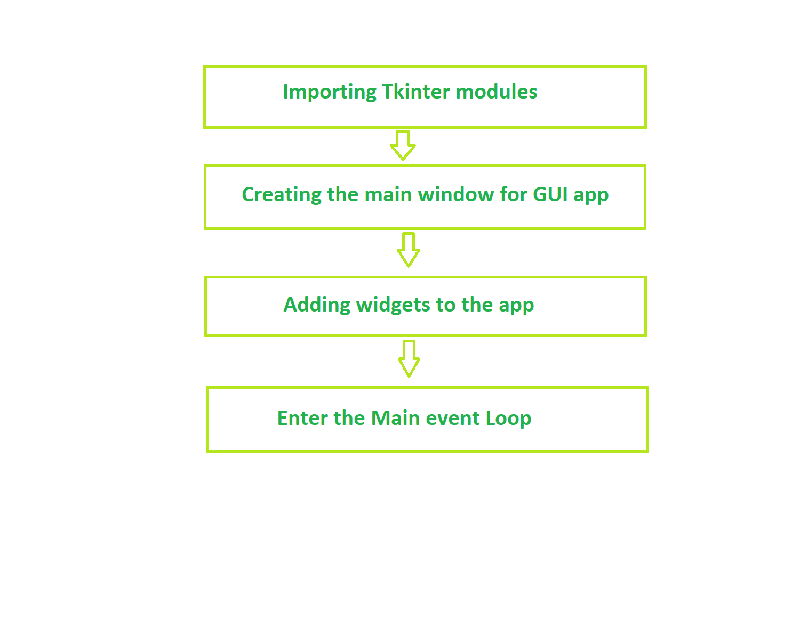
Fundamental structure of tkinter program

Slide 336
Widgets
In general, Widget is an element of Graphical User Interface (GUI) that displays/illustrates information or gives a way for the user to interact with the OS. In Tkinter , Widgets are objects ; instances of classes that represent buttons, frames, and so on.
Each separate widget is a Python object. When creating a widget, you must pass its parent as a parameter to the widget creation function. The only exception is the “root” window, which is the top-level window that will contain everything else and it does not have a parent.

Slide 337
Widgets Description
Label It is used to display text or image on the screen
Button It is used to add buttons to your application
Canvas It is used to draw pictures and others layouts like texts, graphics
etc.
ComboBox It contains a down arrow to select from list of available options
CheckButton It displays a number of options to the user as toggle buttons from
which user can select any number of options.
RadiButton It is used to implement one-of-many selection as it allows only one
option to be Selected.
Entry It is used to input single line text entry from user
Frame It is used as container to hold and organize the widgets

Slide 338
To create a tkinter app:
Importing the module – tkinter
Create the main window (container)
Add any number of widgets to the main window
Apply the event Trigger on the widgets.
Importing tkinter is same as importing any other module in the Python code. Note that the name of the module in Python 2.x is ‘Tkinter’ and in Python 3.x it is ‘tkinter’.
There are two main methods used which the user needs to remember while creating the Python application with GUI.
import tkinter

Slide 339
Hello World in Tkinter
Tkinter is the Python GUI framework that is build into the Python standard library. Out of all the GUI methods, tkinter is the most commonly used method as it provides the fastest and the easiest way to create the GUI application.
Creating the Hello World program in Tkinter
Lets start with the ‘hello world’ tutorial. Here is the explanation for the first program in tkinter:
from tkinter import *
In Python3 firstly we import all the classes, functions and variables from the tkinter package.

Slide 340
root=Tk()
Now we create a root widget, by calling the Tk(). This automatically creates a graphical window with the title bar, minimize, maximize and close buttons. This handle allows us to put the contents in the window and reconfigure it as necessary.
a = Label(root, text="Hello, world!")
Now we create a Label widget as a child to the root window. Here root is the parent of our label widget. We set the default text to “Hello, World!”
Note; This gets displayed in the window. A Label widget can display either text or an icon or other image.
a.pack()
Next, we call the pack() method on this widget. This tells it to size itself to fit the given text, and make itself visible.It just tells the geometry manager to put widgets in the same row or column. It’s usually the easiest to use if you just want one or a few widgets to appear.

Slide 341
root.mainloop()
The application window does not appear before you enter the main loop. This method says to take all the widgets and objects we created, render them on our screen, and respond to any interactions. The program stays in the loop until we close the window.

Slide 342
# Python tkinter hello world program
from tkinter import *
root = Tk()
a = Label(root, text ="Hello World")
a.pack()
root.mainloop()

Slide 343
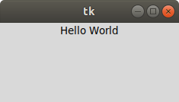
output

Slide 344
Creating a button in tkinter
Tkinter is Python’s standard GUI (Graphical User Interface) package. It is one of the most commonly used packages for GUI applications which comes with Python itself. Let’s see how to create a button using Tkinter.
Follow the below steps:
Import tkinter module # Tkinter in Python 2.x. (Note Capital T)
Create main window (root = Tk())
Add as many widgets as you want.
Importing tkinter module is same as importing any other module.

Slide 345
import tkinter # In Python 3.x
import Tkinter # In python 2.x. (Note Capital T)
The tkinter.ttk module provides access to the Tk-themed widget set, introduced in Tk 8.5. If Python has not been compiled against Tk 8.5, this module can still be accessed if Tile has been installed. The former method using Tk 8.5 provides additional benefits including anti-aliased font rendering under X11 and window transparency.
The basic idea for tkinter.ttk is to separate, to the extent possible, the code implementing a widget’s behavior from the code implementing its appearance. tkinter.ttk is used to create modern GUI (Graphical User Interface) applications that cannot be achieved by tkinter itself.

Slide 346
Creating button using Tkinter.
# import everything from tkinter module
from tkinter import *
# create a tkinter window
root = Tk()
# Open window having dimension 100x100
root.geometry('100x100')
# Create a Button
btn = Button(root, text = 'Click me !', bd = '5',
command = root.destroy)
# Set the position of button on the top of window.
btn.pack(side = 'top')
root.mainloop()

Slide 347
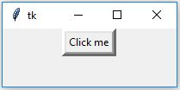
output
Creation of Button without using tk themed widget.
Creation of Button using tk themed widget (tkinter.ttk). This will give you the effects of modern graphics. Effects will change from one OS to another because it is basically for the appearance.

Slide 348
# import tkinter module
from tkinter import *
# Following will import tkinter.ttk module and
# automatically override all the widgets
# which are present in tkinter module.
from tkinter.ttk import *
# Create Object
root = Tk()
# Initialize tkinter window with dimensions 100x100
root.geometry('100x100')
btn = Button(root, text = 'Click me !',
command = root.destroy)
# Set the position of button on the top of window
btn.pack(side = 'top')
root.mainloop()

Slide 349
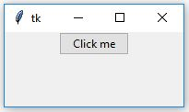
output

Slide 350
Add style to tkinter button
Tkinter is a Python standard library that is used to create GUI (Graphical User Interface) applications. It is one of the most commonly used packages of Python. Tkinter supports both traditional and modern graphics support with the help of Tk themed widgets. All the widgets that Tkinter also has available in tkinter.ttk.
Adding style in a tkinter.ttk button is a little creepy because it doesn’t support direct implementation. To add styling in a ttk.Button we have to first create an object of style class which is available in tkinter.ttk.
We can create ttk.Button by using the following steps:
btn = ttk.Button(master, option = value, ...)

Slide 351
ttk.Button options –
command: A function to be called when button is pressed.
text: Text which appears on the Button.
image: Image to be appeared on the Button.
style: Style to be used in rendering this button.
To add styling on the ttk.Button we cannot directly pass the value in the options. Firstly, we have to create a Style object which can be created as follows:
style = ttk.Style()

Slide 352
Below code will be adding style to only selected Buttons i.e, only those buttons will get changed in which we will be passing style option.
# Import Required Module
from tkinter import *
from tkinter.ttk import *
# Create Object
root = Tk()
# Set geometry (widthxheight)
root.geometry('100x100')
# This will create style object
style = Style()
# This will be adding style, and
# naming that style variable as
# W.Tbutton (TButton is used for ttk.Button).
style.configure('W.TButton', font =
('calibri', 10, 'bold', 'underline'),
foreground = 'red')

Slide 353
# Style will be reflected only on
# this button because we are providing
# style only on this Button.
''' Button 1'''
btn1 = Button(root, text = 'Quit !',
style = 'W.TButton',
command = root.destroy)
btn1.grid(row = 0, column = 3, padx = 100)
''' Button 2'''
btn2 = Button(root, text = 'Click me !', command = None)
btn2.grid(row = 1, column = 3, pady = 10, padx = 100)
# Execute Tkinter
root.mainloop()

Slide 354
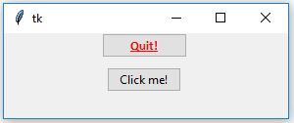
output:
Only one button will get styled because in the above code we are providing styling only in one Button.

Slide 355
# Import Required Module
from tkinter import *
from tkinter.ttk import *
# Create Root Object
root = Tk()
# Set Geometry(widthxheight)
root.geometry('100x100')
# Create style Object
style = Style()
# Will add style to every available button
# even though we are not passing style
# to every button widget.
style.configure('TButton', font =
('calibri', 10, 'bold', 'underline'),
foreground = 'red')

Slide 356
# button 1
btn1 = Button(root, text = 'Quit !',
style = 'TButton',
command = root.destroy)
btn1.grid(row = 0, column = 3, padx = 100)
# button 2
btn2 = Button(root, text = 'Click me !', command = None)
btn2.grid(row = 1, column = 3, pady = 10, padx = 100)
# Execute Tkinter
root.mainloop()

Slide 357
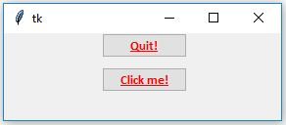
output:

Slide 358
Add image on a Tkinter button
Tkinter is a Python module which is used to create GUI (Graphical User Interface) applications with the help of varieties of widgets and functions. Like any other GUI module it also supports images i.e you can use images in the application to make it more attractive.
Image can be added with the help of PhotoImage() method. This is a Tkinter method which means you don’t have to import any other module in order to use it.
Important: If both image and text are given on Button, the text will be dominated and only image will appear on the Button. But if you want to show both image and text then you have to pass compound in button options.
Button(master, text = "Button", image = "image.png", compound=LEFT)
compound = LEFT -> image will be at left side of the button
compound = RIGHT -> image will be at right side of button
compound = TOP -> image will be at top of button
compound = BOTTOM -> image will be at bottom of button

Slide 359
Syntax:
photo = PhotoImage(file = "path_of_file")
path_of_file is any valid path available on your local machine.
Tkinter – Label
Python offers multiple options for developing a GUI (Graphical User Interface). Out of all the GUI methods, Tkinter is the most commonly used method. It is a standard Python interface to the Tk GUI toolkit shipped with Python. Python with Tkinter is the fastest and easiest way to create GUI applications. Creating a GUI using Tkinter is an easy task using widgets. Widgets are standard graphical user interfaces (GUI) elements, like buttons and menus.
Label Widget
Tkinter Label is a widget that is used to implement display boxes where you can place text or images. The text displayed by this widget can be changed by the developer at any time you want. It is also used to perform tasks such as to underline the part of the text and span the text across multiple lines. It is important to note that a label can use only one font at a time to display text. To use a label, you just have to specify what to display in it (this can be text, a bitmap, or an image).

Slide 360
Syntax:
w = Label ( master, option, … )
Parameters:
master: This represents the parent window
options: Below is the list of most commonly used options for this widget. These options can be used as key-value pairs separated by commas:
Various Options are:
anchor: This options is used to control the positioning of the text if the widget has more space than required for the text. The default is anchor=CENTER, which centers the text in the available space.
bg:This option is used to set the normal background clior displayed behind the label and indicator.

Slide 361
height:This option is used to set the vertical dimension of the new frame.
width:Width of the label in characters (not pixels!). If this option is not set, the label will be sized to fit its contents.
bd:This option is used to set the size of the border around the indicator. Default bd value is set on 2 pixels.
font:If you are displaying text in the label (with the text or textvariable option), the font option is used to specify in what font that text in the label will be displayed.
cursor:It is used to specify what cursor to show when the mouse is moved over the label. The default is to use the standard cursor.
textvariable: As the name suggests it is associated with a Tkinter variable (usually a StringVar) with the label. If the variable is changed, the label text is updated.

Slide 362
bitmap:It is used to set the bitmap to the graphical object specified so that, the label can represent the graphics instead of text.
fg:The label clior, used for text and bitmap labels. The default is system specific. If you are displaying a bitmap, this is the clior that will appear at the position of the 1-bits in the bitmap.
image: This option is used to display a static image in the label widget.
padx:This option is used to add extra spaces between left and right of the text within the label.The default value for this option is 1.
pady:This option is used to add extra spaces between top and bottom of the text within the label.The default value for this option is 1.
justify:This option is used to define how to align multiple lines of text. Use LEFT, RIGHT, or CENTER as its values. Note that to position the text inside the widget, use the anchor option. Default value for justify is CENTER.

Slide 363
relief: This option is used to specify appearance of a decorative border around the label. The default value for this option is FLAT.
underline:This
wraplength:Instead of having only one line as the label text it can be broken itno to the number of lines where each line has the number of characters specified to this option.

Slide 364
Create LabelFrame and add widgets to it
Tkinter is a Python module which is used to create GUI (Graphical User Interface) applications. It is a widely used module which comes along with the Python. It consists of various types of widgets which can be used to make GUI more user-friendly and attractive as well as functionality can be increased.
LabelFrame can be created as follows:
-> import tkinter
-> create root
-> create LabelFrame as child of root
label_frame = ttk.LabelFrame(parent, value = options, ...)

Slide 365
Creating LabelFrame and adding a message to it.
# Import only those methods
# which are mentioned below, this way of
# importing methods is efficient
from tkinter import Tk, mainloop, LEFT, TOP
from tkinter.ttk import *
# Creating tkinter window with fixed geometry
root = Tk()
root.geometry('250x150')
# This will create a LabelFrame
label_frame = LabelFrame(root, text = 'This is Label Frame')
label_frame.pack(expand = 'yes', fill = 'both')

Slide 366
label1 = Label(label_frame, text = '1. This is a Label.')
label1.place(x = 0, y = 5)
label2 = Label(label_frame, text = '2. This is another Label.')
label2.place(x = 0, y = 35)
label3 = Label(label_frame,
text = '3. We can add multiple\n widgets in it.')
label3.place(x = 0, y = 65)
# This creates an infinite loop which generally
# waits for any interrupt (like keyboard or
# mouse) to terminate
mainloop()

Slide 367
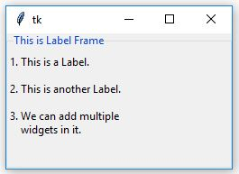
output:

Slide 368
Git and GitHub

Slide 369
What Is Git and GitHub?
Git: Git is a distributed version control system for tracking changes in source code during software development. It is designed for coordinating work among programmers, but it can be used to track changes in any set of files. Its goals include speed, data integrity, and support for distributed, non-linear workflows.
GitHub: GitHub is a web-based Git repository hosting service, which offers all of the distributed revision control and source code management (SCM) functionality of Git as well as adding its own features

Slide 370
Integration with Pycharm
Step 1: Download the Git Version Control Software
It is an open-source version control software. It
is useful for creating version control locally. Use following link:
https://git-scm.com/

Slide 371
Create a new demo project and enabling version control on it and name it.
Then go to VCS > Import intro version control> create Git Repository
You will have to select a folder existing or newly created

Slide 372
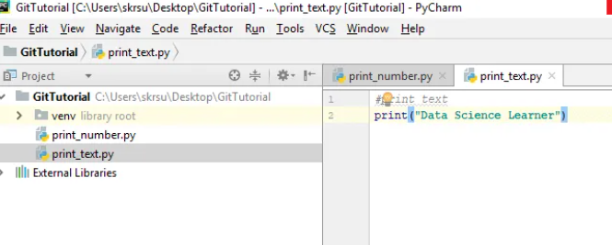
After selecting the desired Folder, all files inside that folder will turn red.

Slide 373
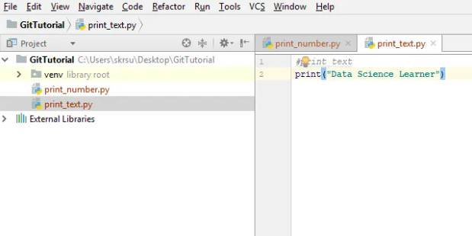

Slide 374
Continue..
To manually add files right click on the file and click on git > Add.
You can also add all the files inside the folder by selecting that folder and click add.
To commit the files right click on the folder or single file and click on git > commit file a window like below will appear

Slide 375
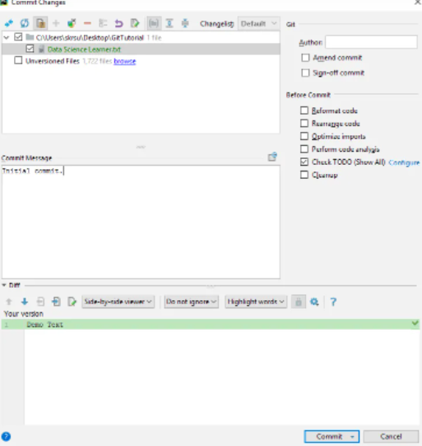

Slide 376
3. Integrate Github with Pycharm
Cloning and pulling from github
Go to vcs > checkout from version control and select github. Enter your user name and password
Select the desired repository URL. Now you clone and pull the files from that url

Slide 377
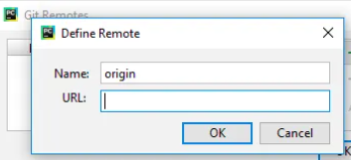
Pushing to the Github
Right click on the file and go to git > repository and click on remotes. A window will appear fill in the repository and url of the repository

Slide 378
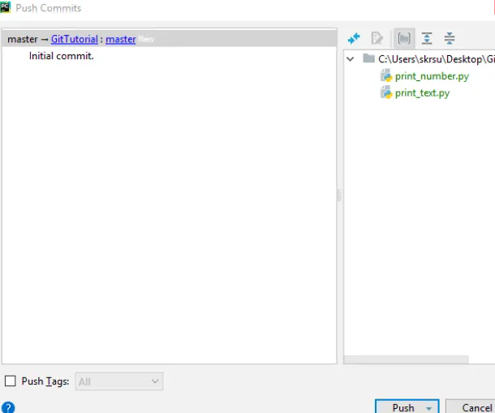
Go to Git > Repository and click on push

